Slide 1
Raspberry Pi GPIO + MCS Cloud

Slide 2
DHT-11 溫溼度感應器

Slide 3
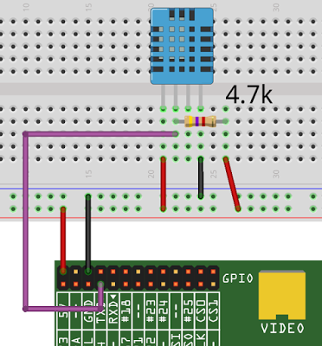
Reference
http://yehnan.blogspot.tw/2015/05/raspberry-pidht11.html

Slide 4
Github
登入自己的 Github 帳號
將 DHT-11 Library: https://github.com/adafruit/Adafruit_Python_DHT.git 使用 fork 複製到自己帳號

Slide 5
Packages
先安裝所需套件： $ sudo apt-get update $ sudo apt-get install build-essential python-dev git 然後下載 (需輸入 github 帳號及密碼)，進入該目錄： $ git clone https://github.com/username/Adafruit_Python_DHT.git $ cd Adafruit_Python_DHT 安裝： $ sudo python setup.py install 接著就能讀取DHT11了，執行寫好的範例Python程式： $ cd examples $ sudo ./AdafruitDHT.py 11 4 Temp=27.0*C Humidity=81.0% 其中參數11代表DHT11，4代表我把它接到Raspberry Pi的GPIO 4。

Slide 6
Modify AdafruitDHT.py
#!/usr/bin/python3
# Try to grab a sensor reading. Use the read_retry method which will retry up
# to 15 times to get a sensor reading (waiting 2 seconds between each retry).
humidity, temperature = Adafruit_DHT.read_retry(sensor, pin)
# Un-comment the line below to convert the temperature to Fahrenheit.
# temperature = temperature * 9/5.0 + 32
# Note that sometimes you won't get a reading and
# the results will be null (because Linux can't
# guarantee the timing of calls to read the sensor).
# If this happens try again!
if humidity is not None and temperature is not None:
print('Temp={0:0.1f}* Humidity={1:0.1f}%'.format(temperature, humidity))
else:
print('Failed to get reading. Try again!')
sys.exit(1)

Slide 7
Modify AdafruitDHT.py
while true:
h0, t0 = Adafruit_DHT.read_retry(sensor, pin)
if h0 is not None and t0 is not None:
print('Temp={0:0.1f}* Humidity={1:0.1f}%'.format(t0, h0))
else:
print('Failed to get reading. Try again!')
sys.exit(1)

Slide 8
Upload to github
將所有變更寫入資料庫
git commit
上傳到 github
git push

Slide 9
CHECK POINT #1
讓 DHT-11 可以一直量測溫溼度
並將程式上傳到 github

Slide 10
MCS Cloud

Slide 11
Reference
http://oranwind.org/-linkit-smart-7688-chuan-song-sensor-data-dao-mediatek-cloud-sandbox-mcs/

Slide 12
MediaTek Cloud Sandbox (MCS) 端

Slide 13
Step 1:
到 MediaTek Cloud Sandbox (MCS) 網站申請帳號
https://mcs.mediatek.com

Slide 14

Step 2: Login

Slide 15
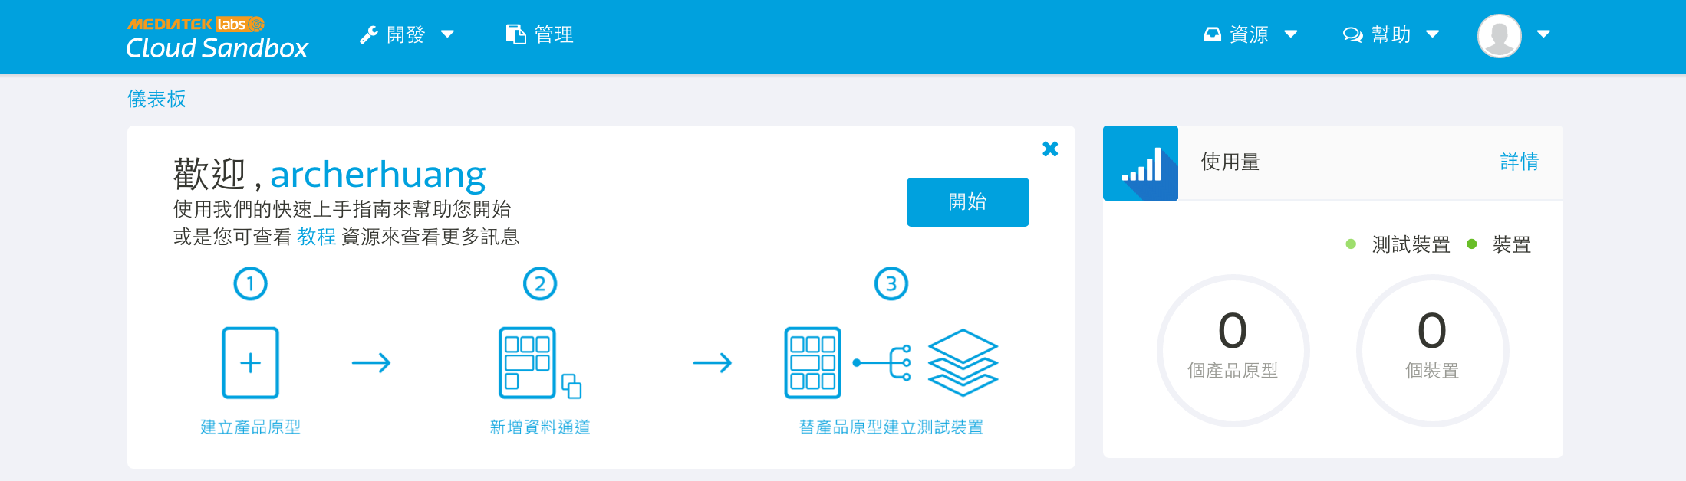
Step 3:點擊 開始

Slide 16
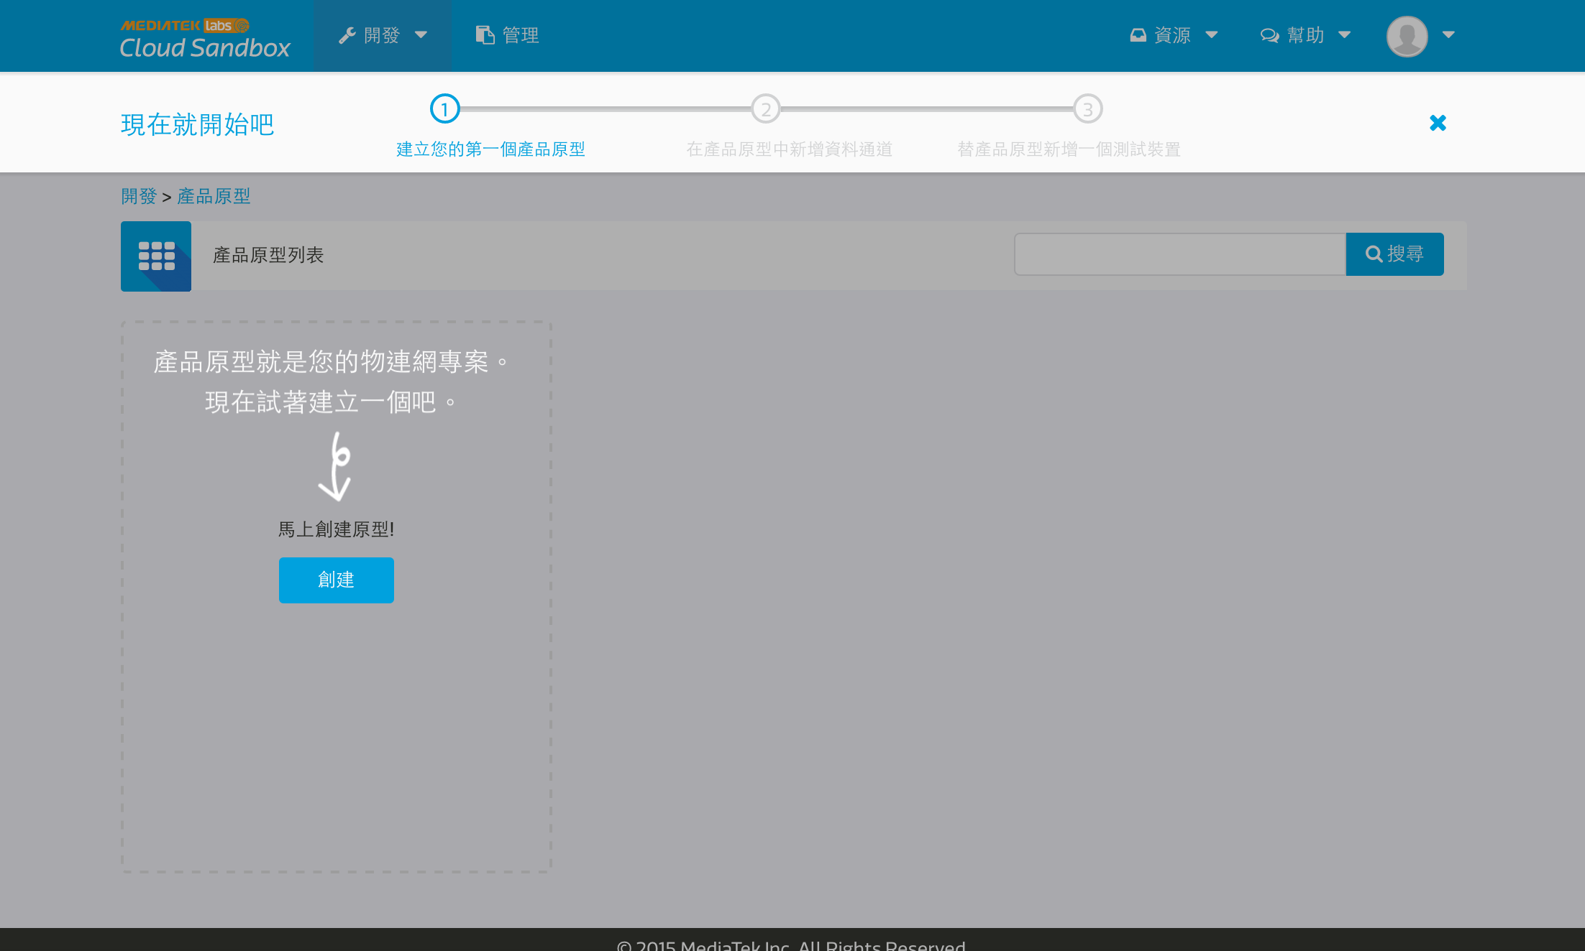
Step 4: 開發 -> 產品原型

Slide 17
Step 5.
輸入 產品原型名稱、產品原型版本、硬體平台、產業、應用程式 再按儲存
硬體平台raspberry pi

Slide 18
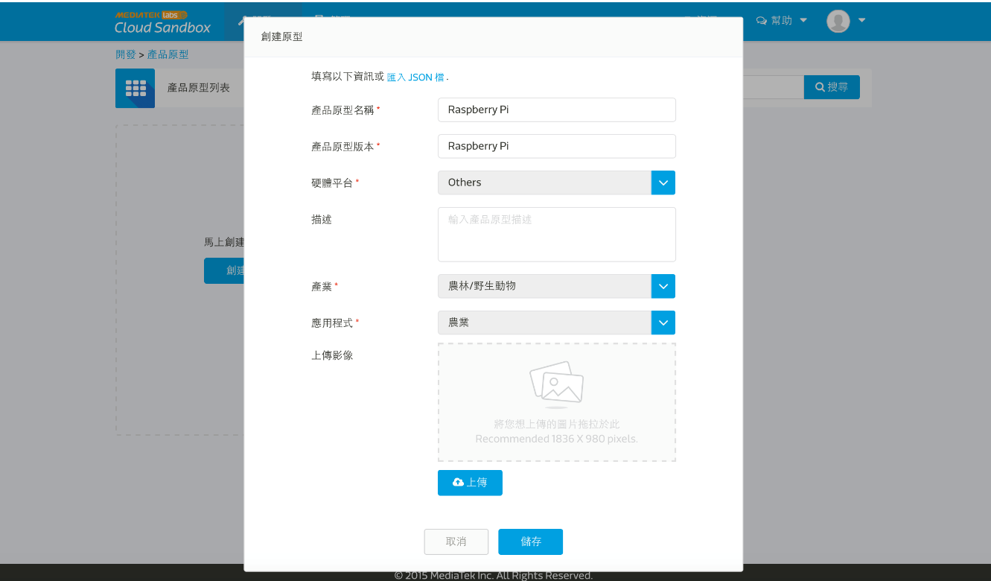

Slide 19
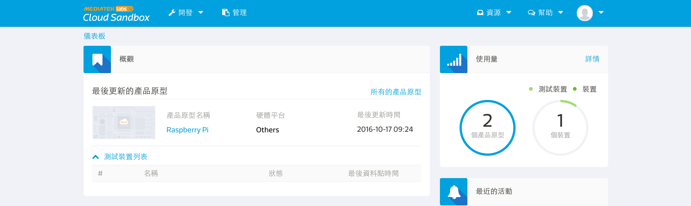
Step 6
點擊 Last updated prototype 中的 raspberry pi

Slide 20
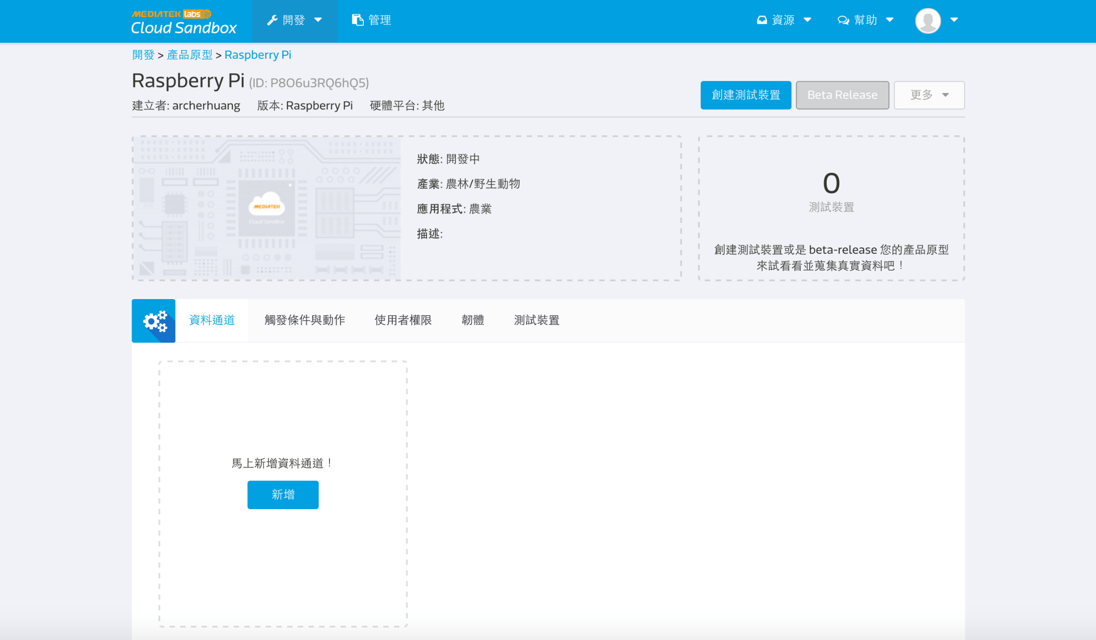
Step 7 Add Data Channel

Slide 21
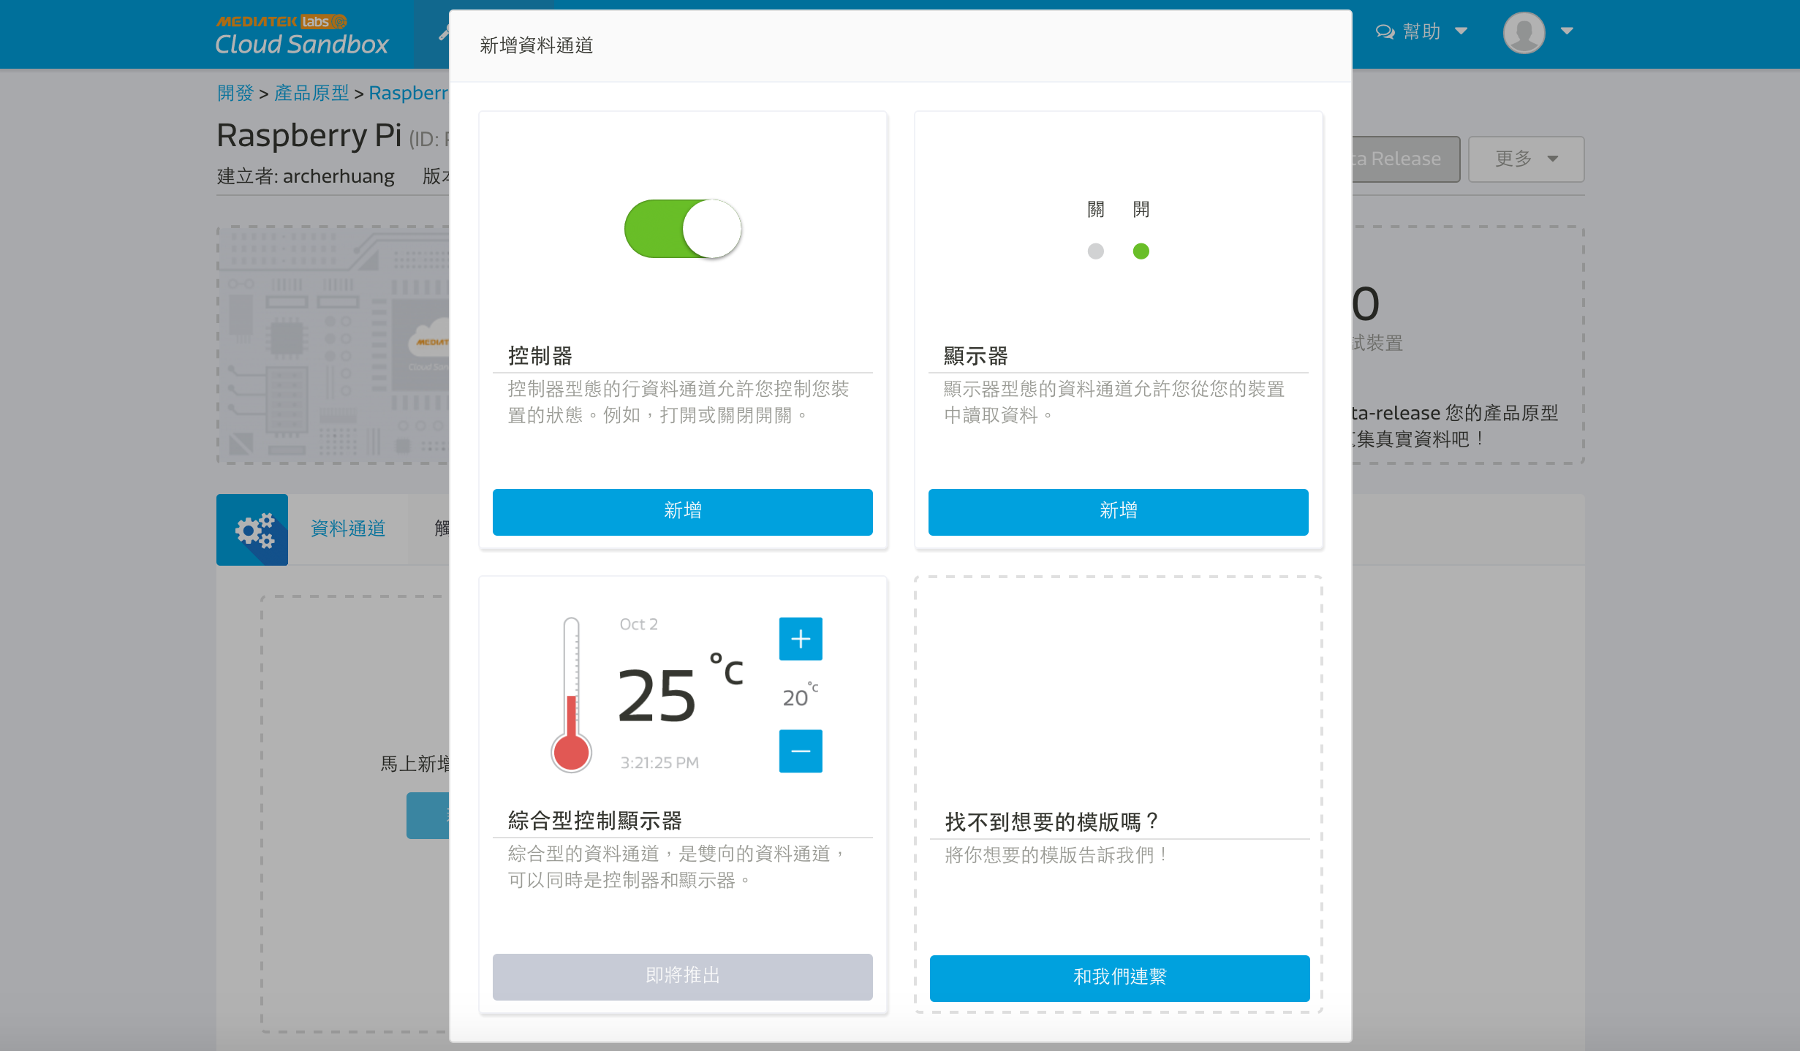
Step 8. Display -> Add

Slide 22
Step 9
輸入 Temperature 的 Data channel name、Data channel Id、Data type、Unit 再按 Save

Slide 23
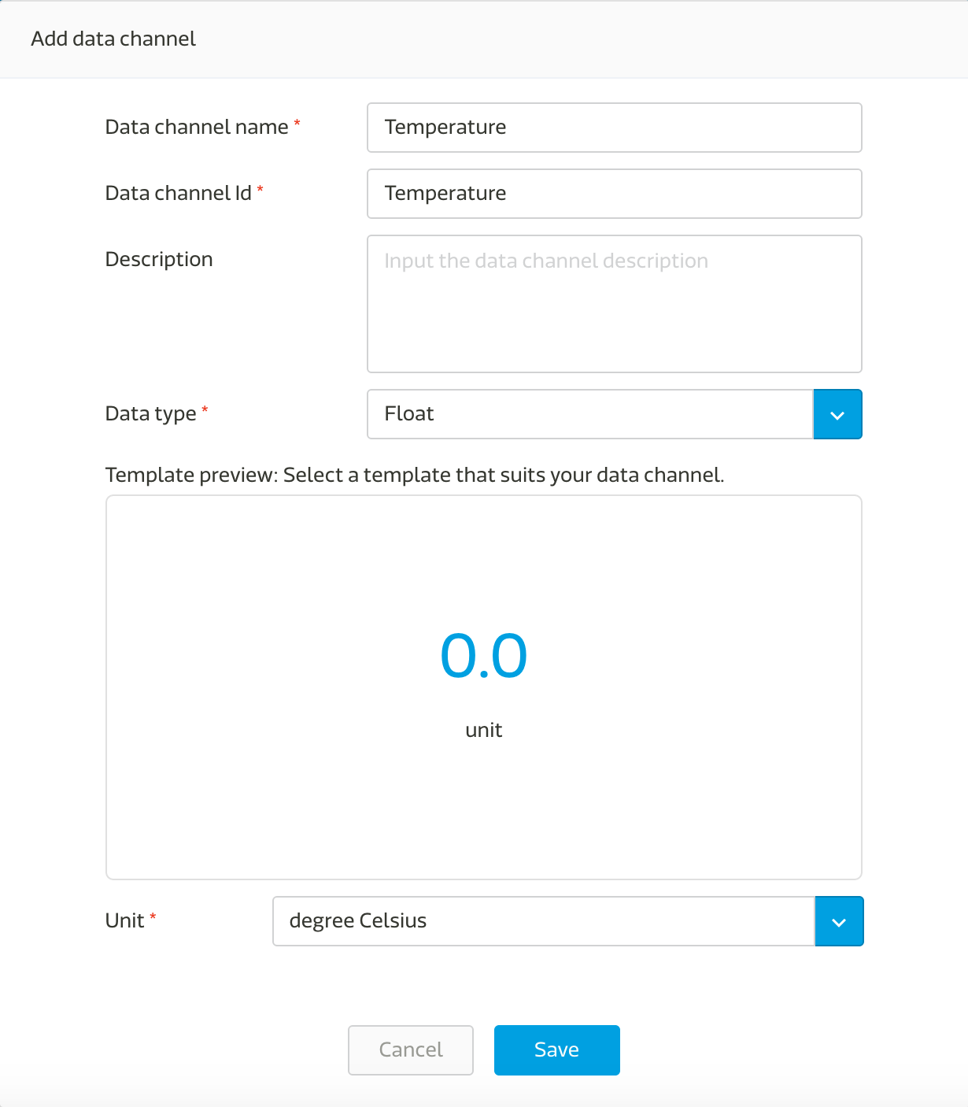

Slide 24
Step 10
Repeat Step 7 – 8.
Add data channel

Slide 25
Step 11
輸入 Humidity 的 Data channel name、Data channel Id、Data type、Unit 再按 Save

Slide 26


Slide 27
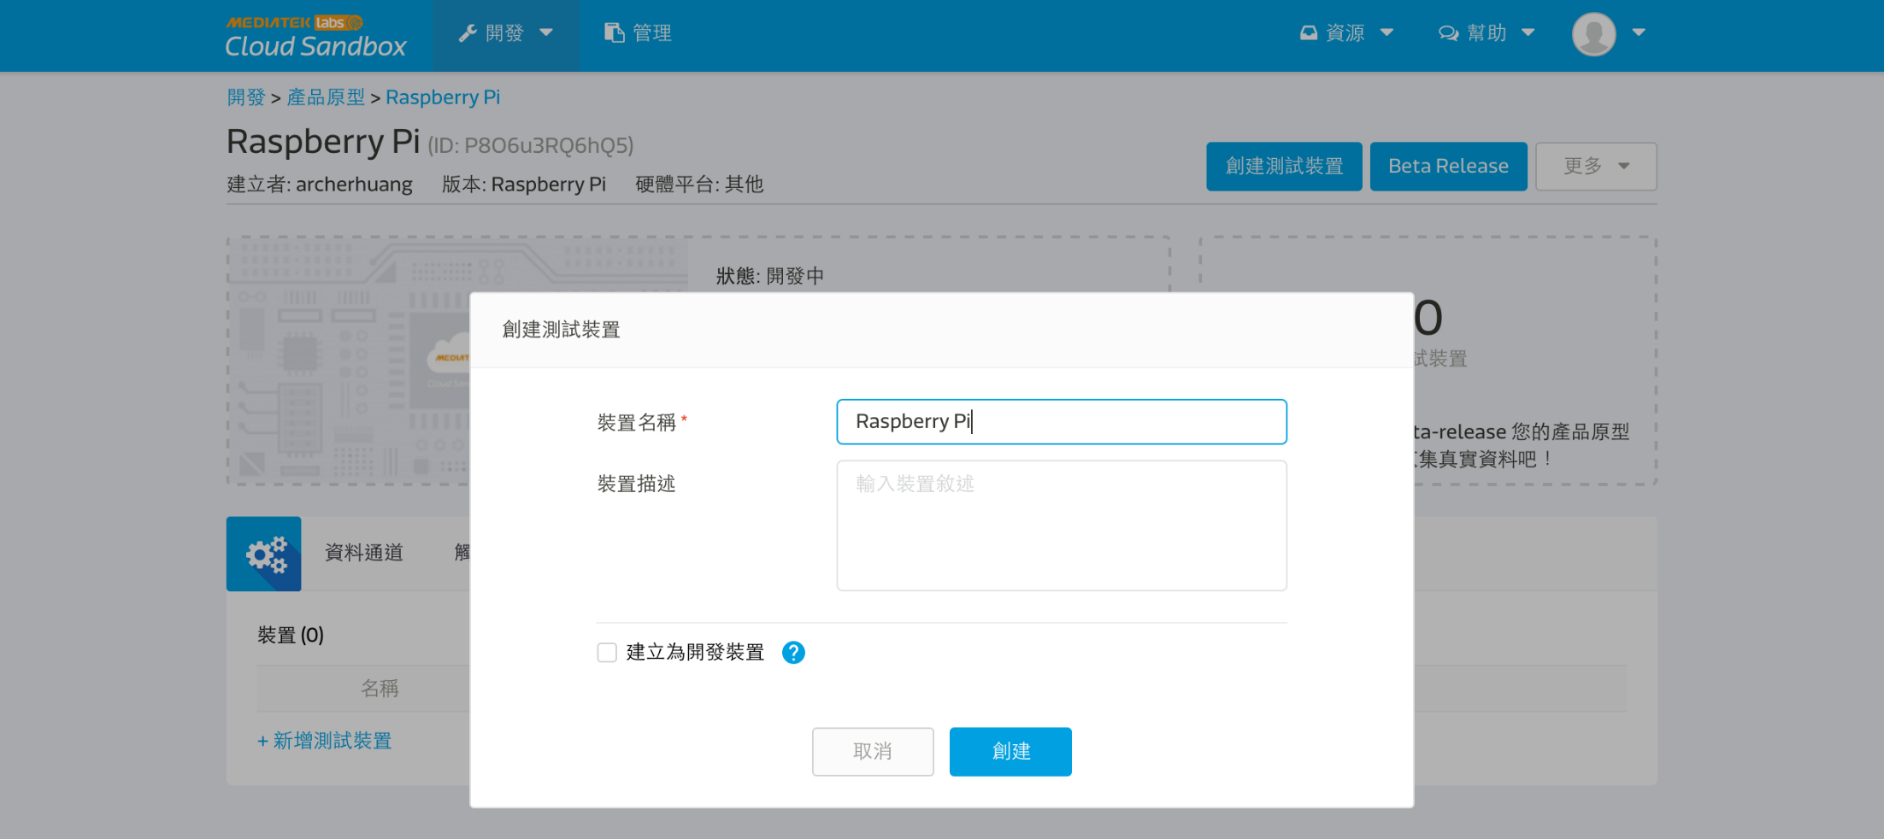
Step 12
點擊 Create Test device 輸入 raspberry pi

Slide 28
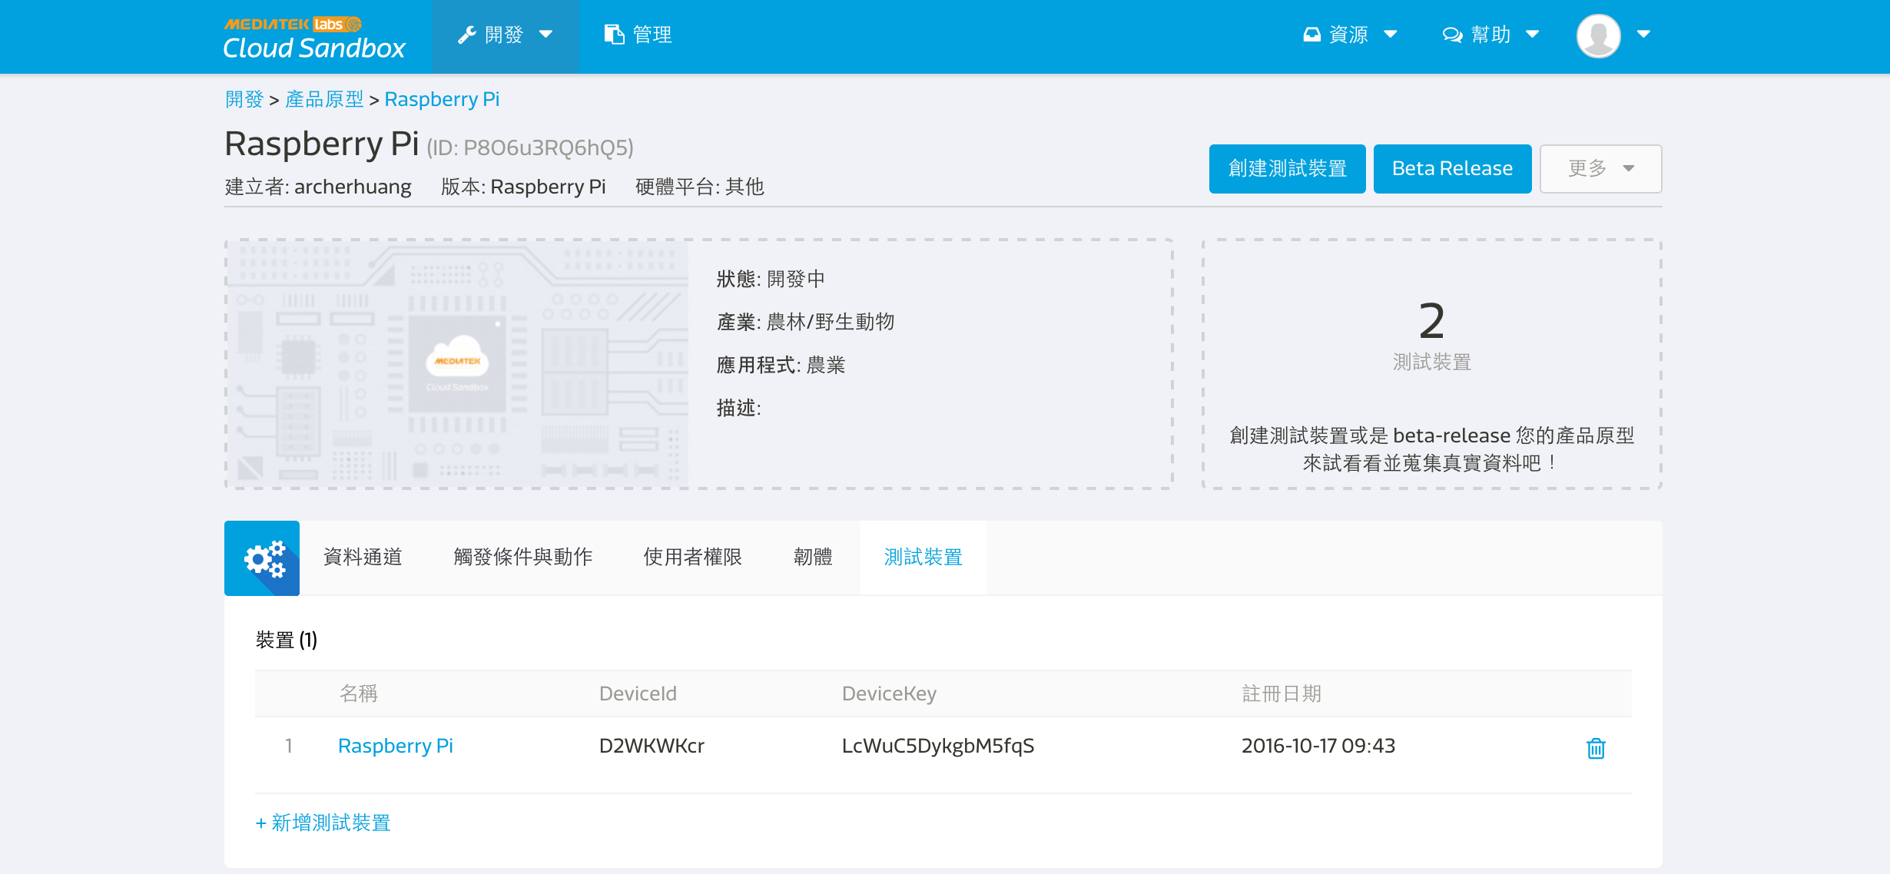
點擊下方 裝置 中的 Raspberry Pi
取得 DeviceId 與 DeviceKey

Slide 29
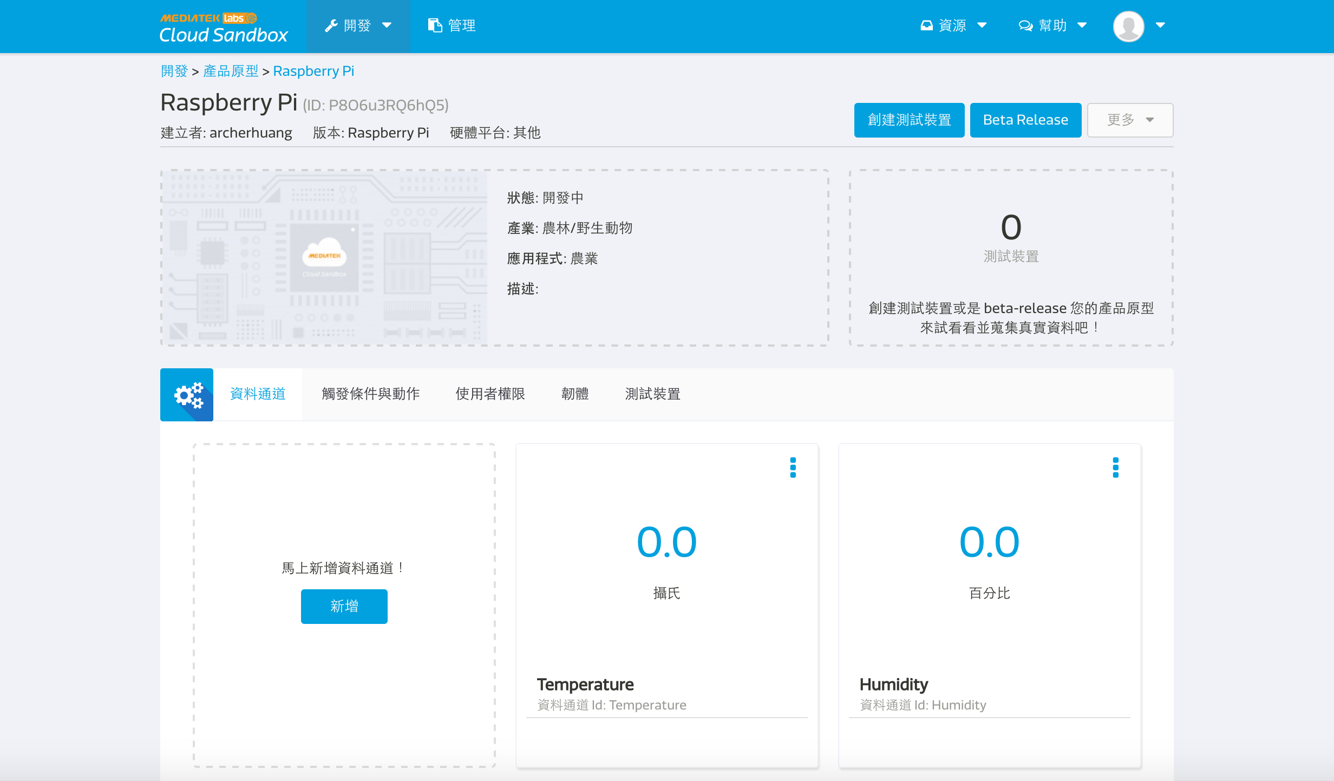

Slide 30
Step 13 – Modify AdafruitDHT.py add post_to_mcs function
http.client.HTTPConnection
#/usr/bin/python3
import time
import sys
import http.client as http
Import urllib
import json
deviceId = "D2WKWKcr “
deviceKey = “LcWuC5DykgbM5fqS“
def post_to_mcs(payload):
headers = {"Content-type": "application/json", "deviceKey": deviceKey}
not_connected = 1
while (not_connected):
try:
conn = http.HTTPConnection("api.mediatek.com:80")
conn.connect()
not_connected = 0
except (http.HTTPException, socket.error) as ex:
print ("Error: %s" % ex)
time.sleep(10)
# sleep 10 seconds
conn.request("POST", "/mcs/v2/devices/" + deviceId + "/datapoints", json.dumps(payload), headers)
response = conn.getresponse()
print( response.status, response.reason, json.dumps(payload), time.strftime("%c"))
data = response.read()
conn.close()

Slide 31
Modify AdafruitDHT.py
while true:
h0, t0= Adafruit_DHT.read_retry(sensor, pin)
if h0 is not None and t0 is not None:
print('Temp={0:0.1f}* Humidity={1:0.1f}%'.format(t0, h0))
payload = {"datapoints":[{"dataChnId":"Humidity","values":{"value":h0}},
{"dataChnId":"Temperature","values":{"value":t0}}]}
post_to_mcs(payload)
time.sleep(10)
else:
print('Failed to get reading. Try again!')
sys.exit(1)

Slide 32
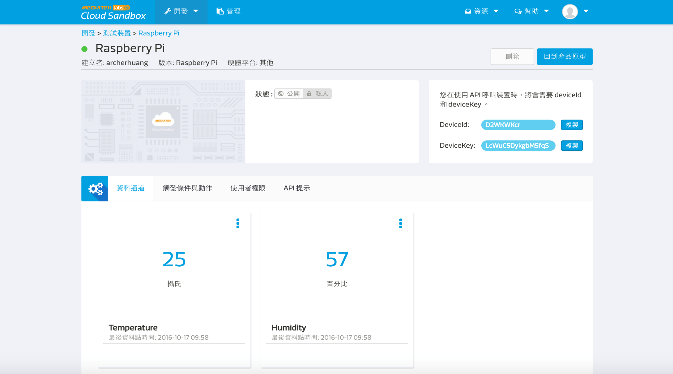

Slide 33
Step 14:上傳 github
git commit
git push

Slide 34
CHECK POINT 2
MCS Cloud 持續顯示溫濕度

Slide 35
MCS Cloud 顯示開關狀態

Slide 36
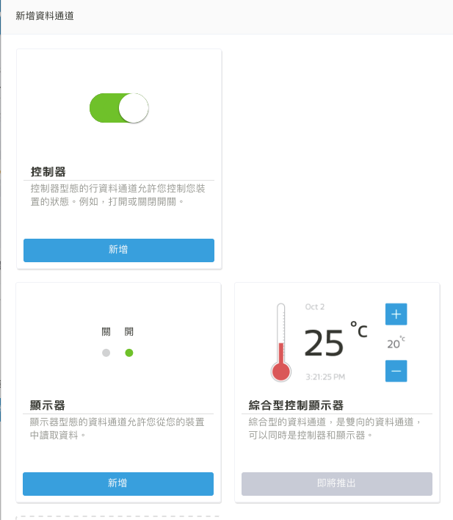
新增資料通道 -> 顯示器

Slide 37
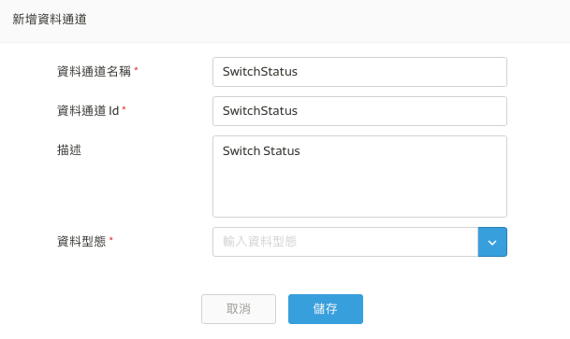
資料型態 -> 開關

Slide 38
GitHub
在 Github 建立一個新的 Repo MCS
將 MCS 下載到 Rpi
cd
git clone https://xxxxxxxxx/MCS
新增一個檔案 mcsio.py
更改權限 chmod +x mcsio.py
將檔案加入 git
git add mcsio.py

Slide 39
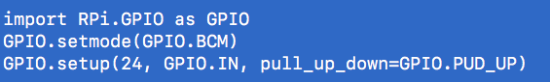
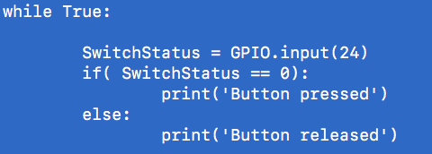
Python 讀取 GPIO 狀態

Slide 40
將開關狀態上傳 MCS Cloud

Slide 41
上傳 github
git commit
git push

Slide 42
CHECK POINT 3
MCS Cloud 持續顯示溫濕度及開關狀態

Slide 43
MCS Cloud 控制 LED

Slide 44
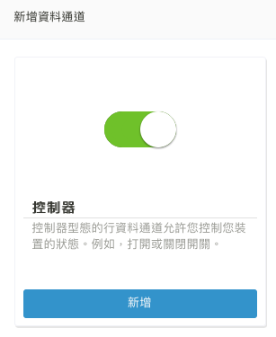
新增資料通道 控制器

Slide 45
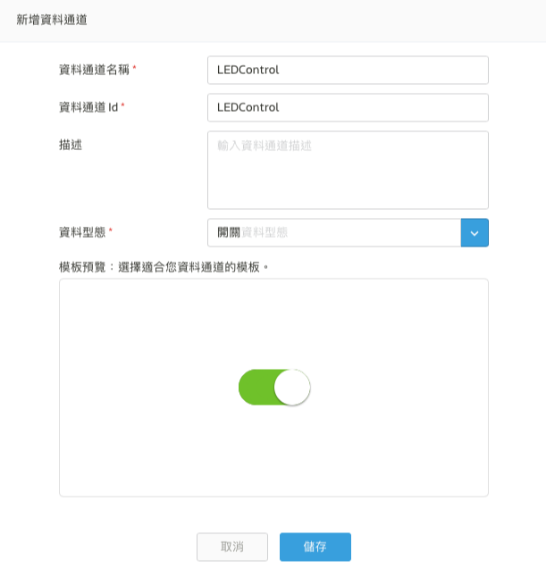
資料通道 -> LEDControl

Slide 46
Reference
http://draw-bruce.blogspot.tw/2016/01/iot10-mediatek-cloud-sandbox.html

Slide 47
CHECK POINT 4
MCS Cloud 直接控制 LED

Slide 48
MCS Cloud 場景

Slide 49
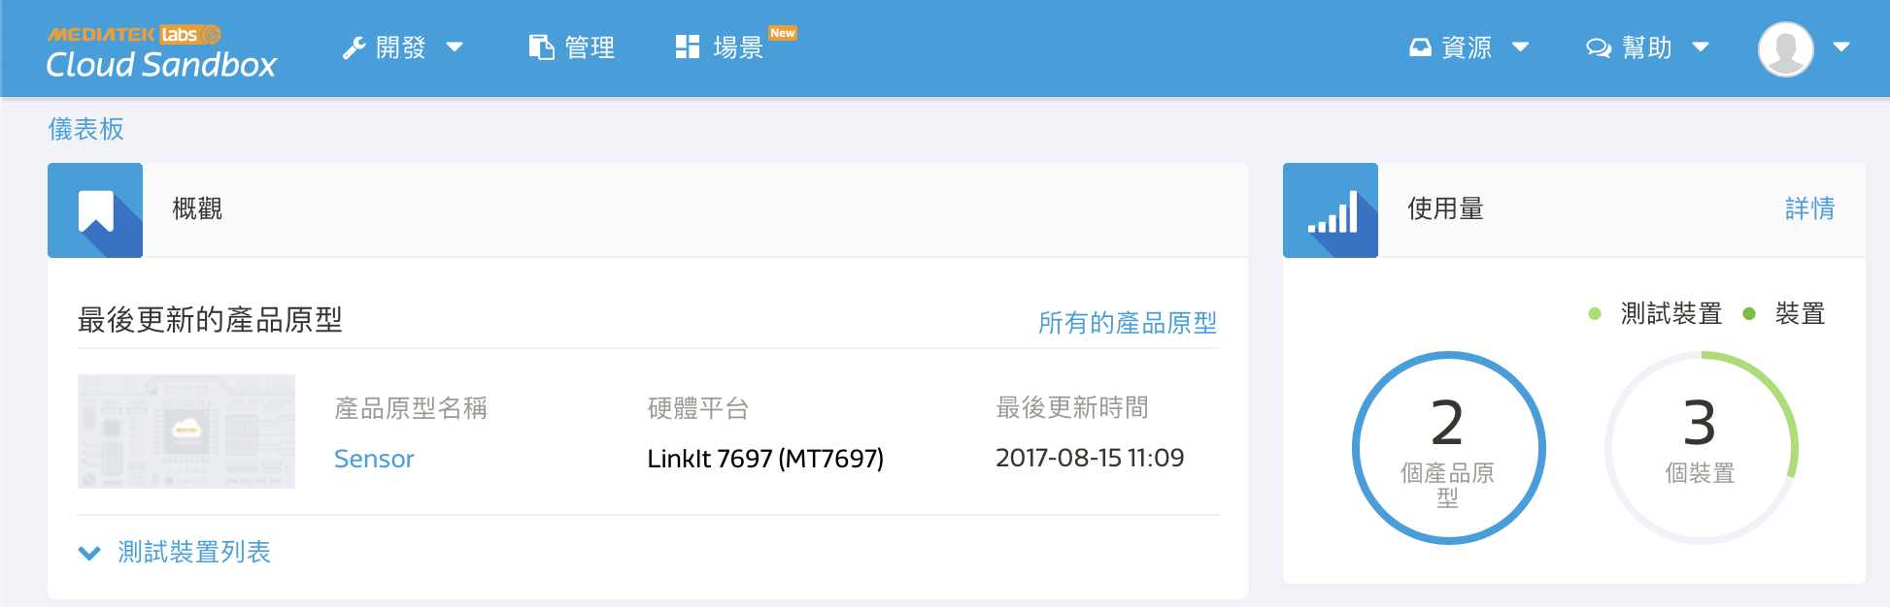
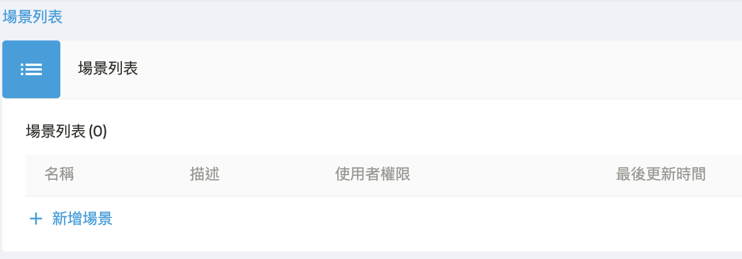
MCS Cloud 主畫面選擇場景

Slide 50
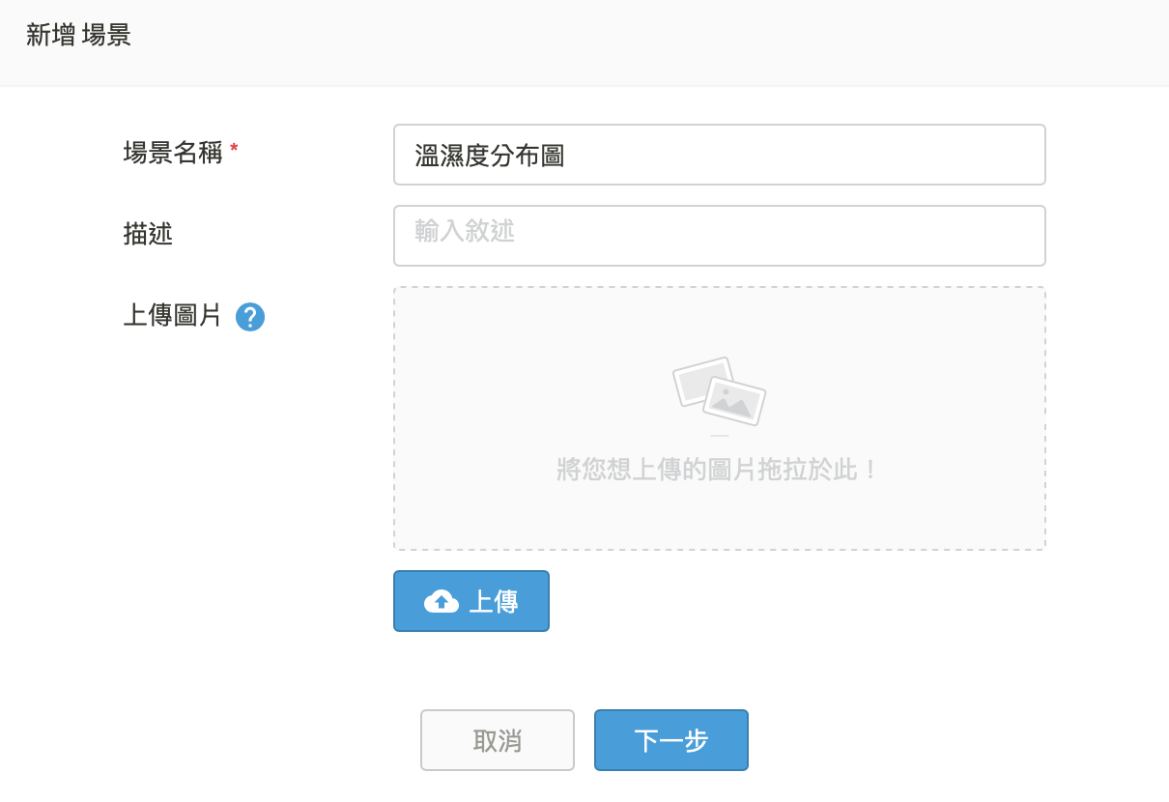
新增場景

Slide 51
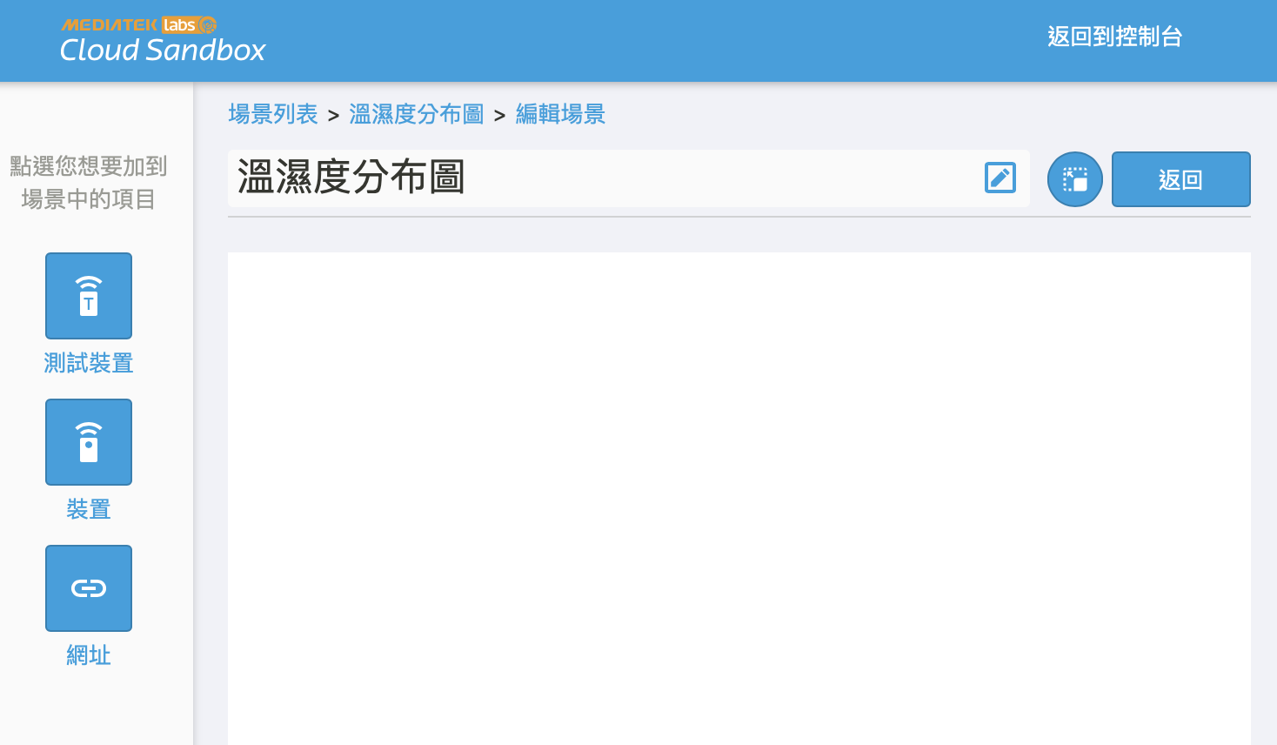
加入測試裝置

Slide 52
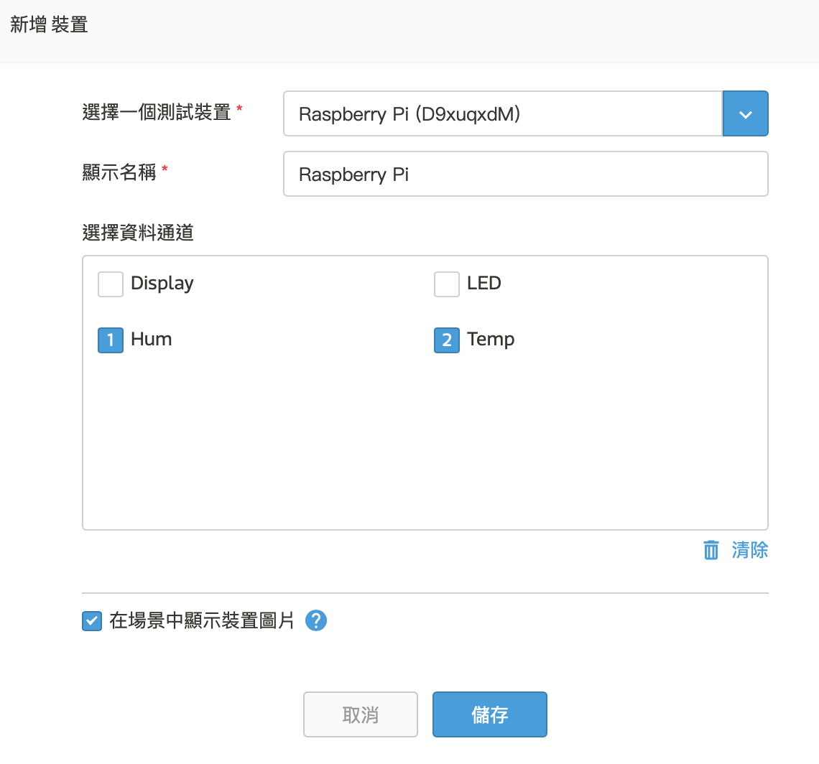
將測試裝置加入

Slide 53
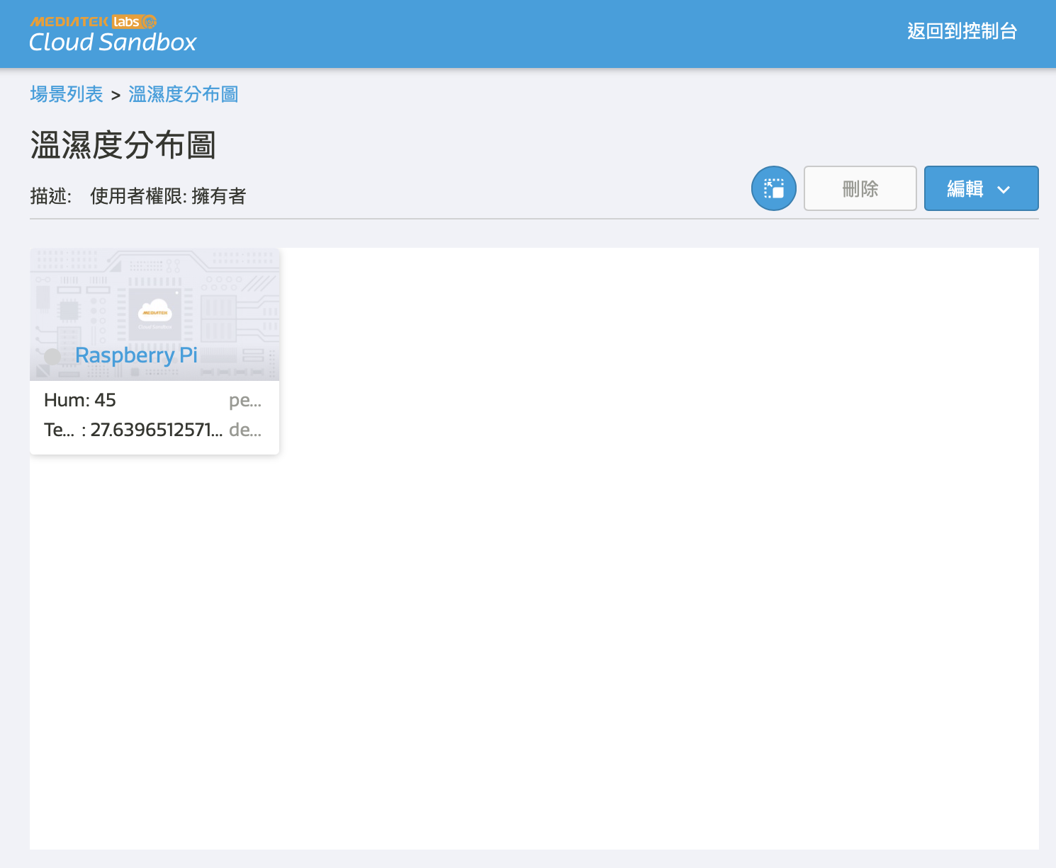
確認結果

Slide 54
IFTTT
IF This then That
Ifttt.com

Slide 55


Slide 56
教學
MCS 連通 IFTTT 基礎教學
MCS 原廠教學
IFTTT Webhooks

Slide 57
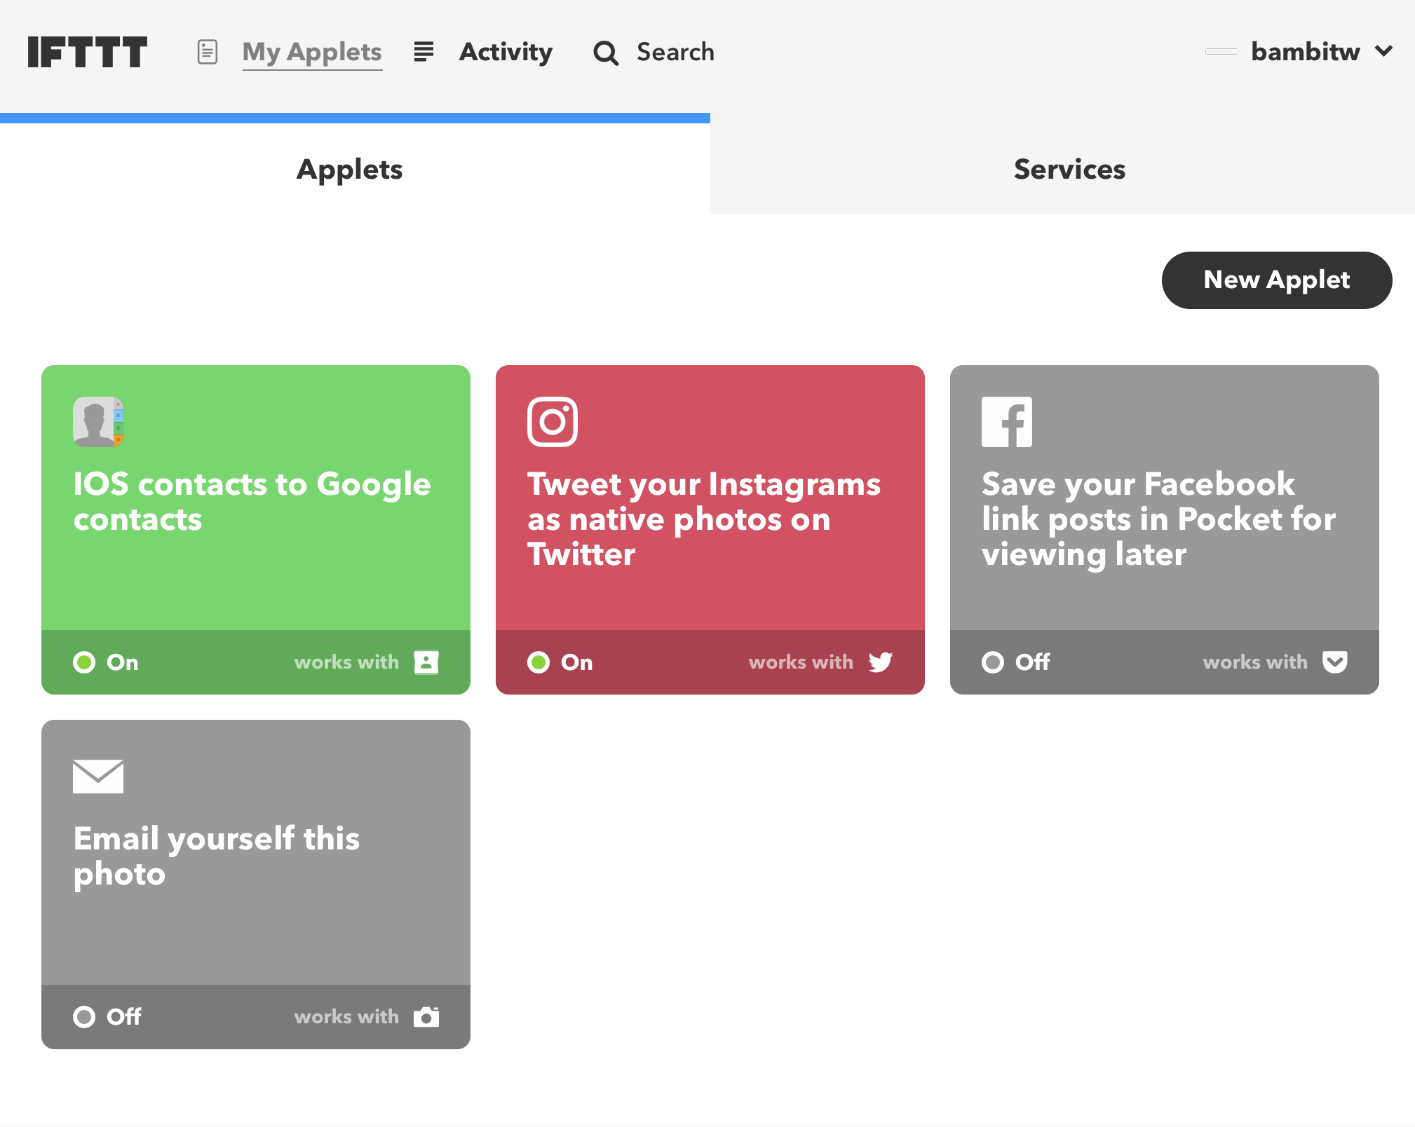
New Applet

Slide 58
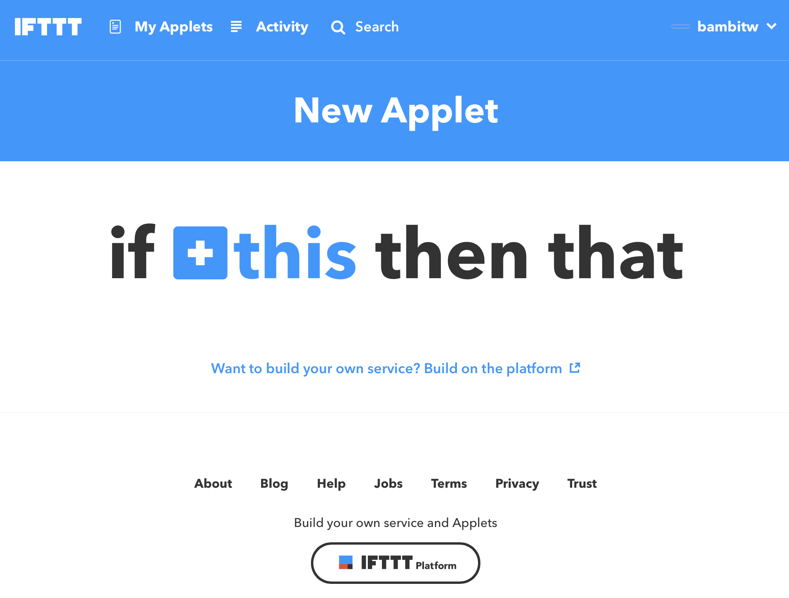
Step 1: this

Slide 59

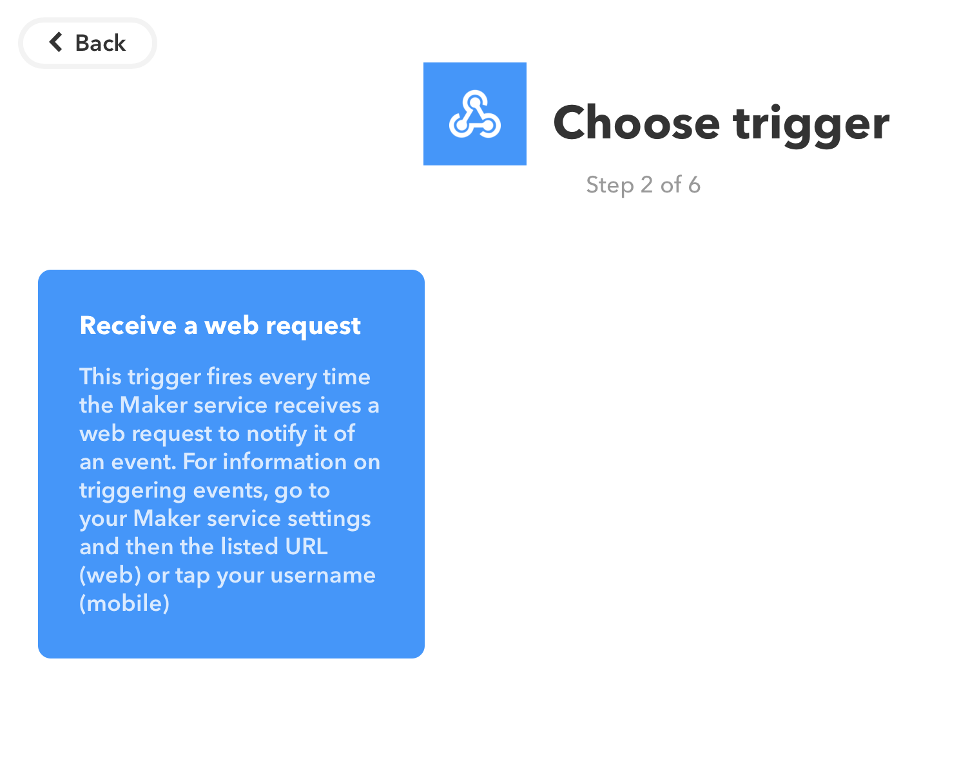
Webhooks

Slide 60
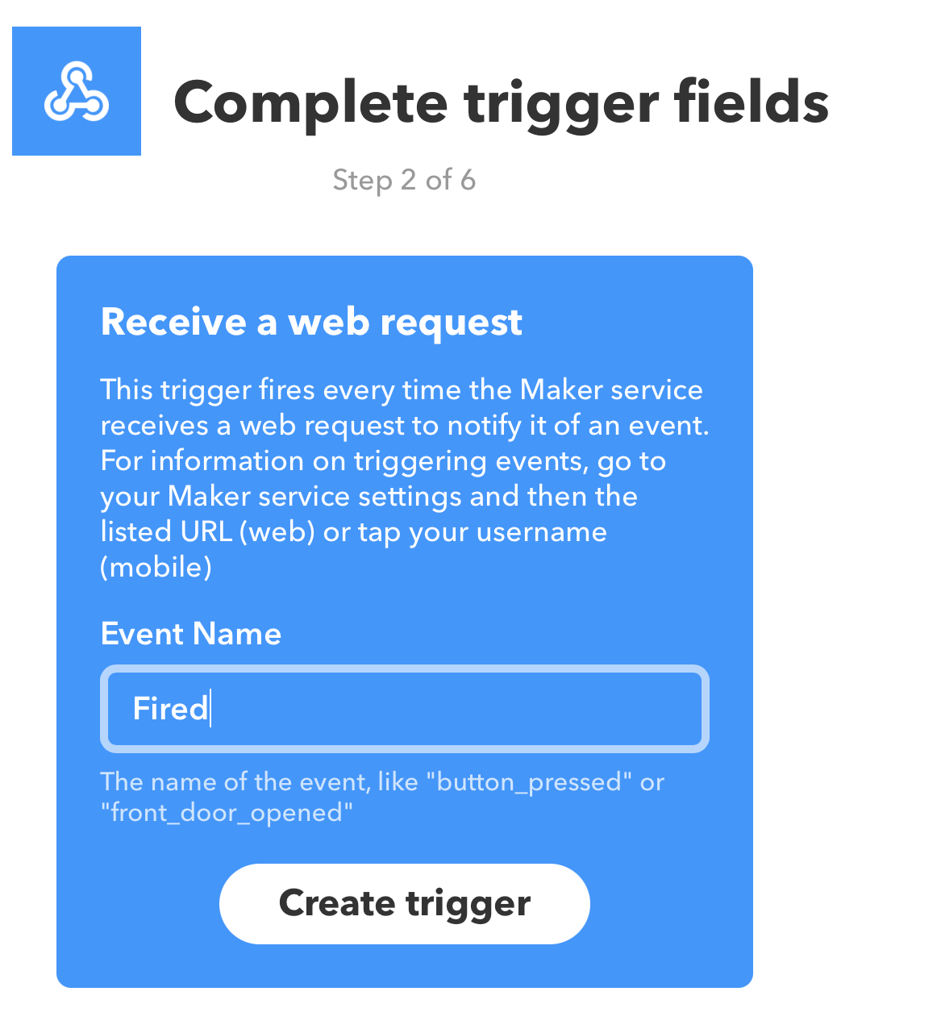
自訂一個 EventName, 要記下來

Slide 61

Step 2: That

Slide 62

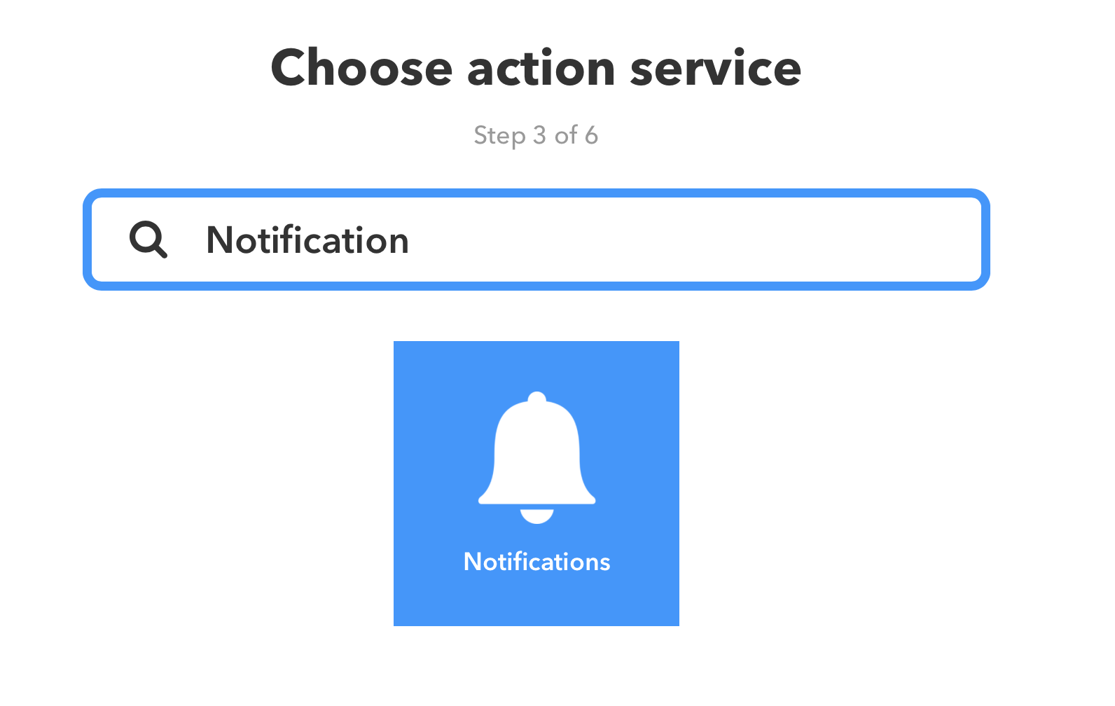
選Notification

Slide 63
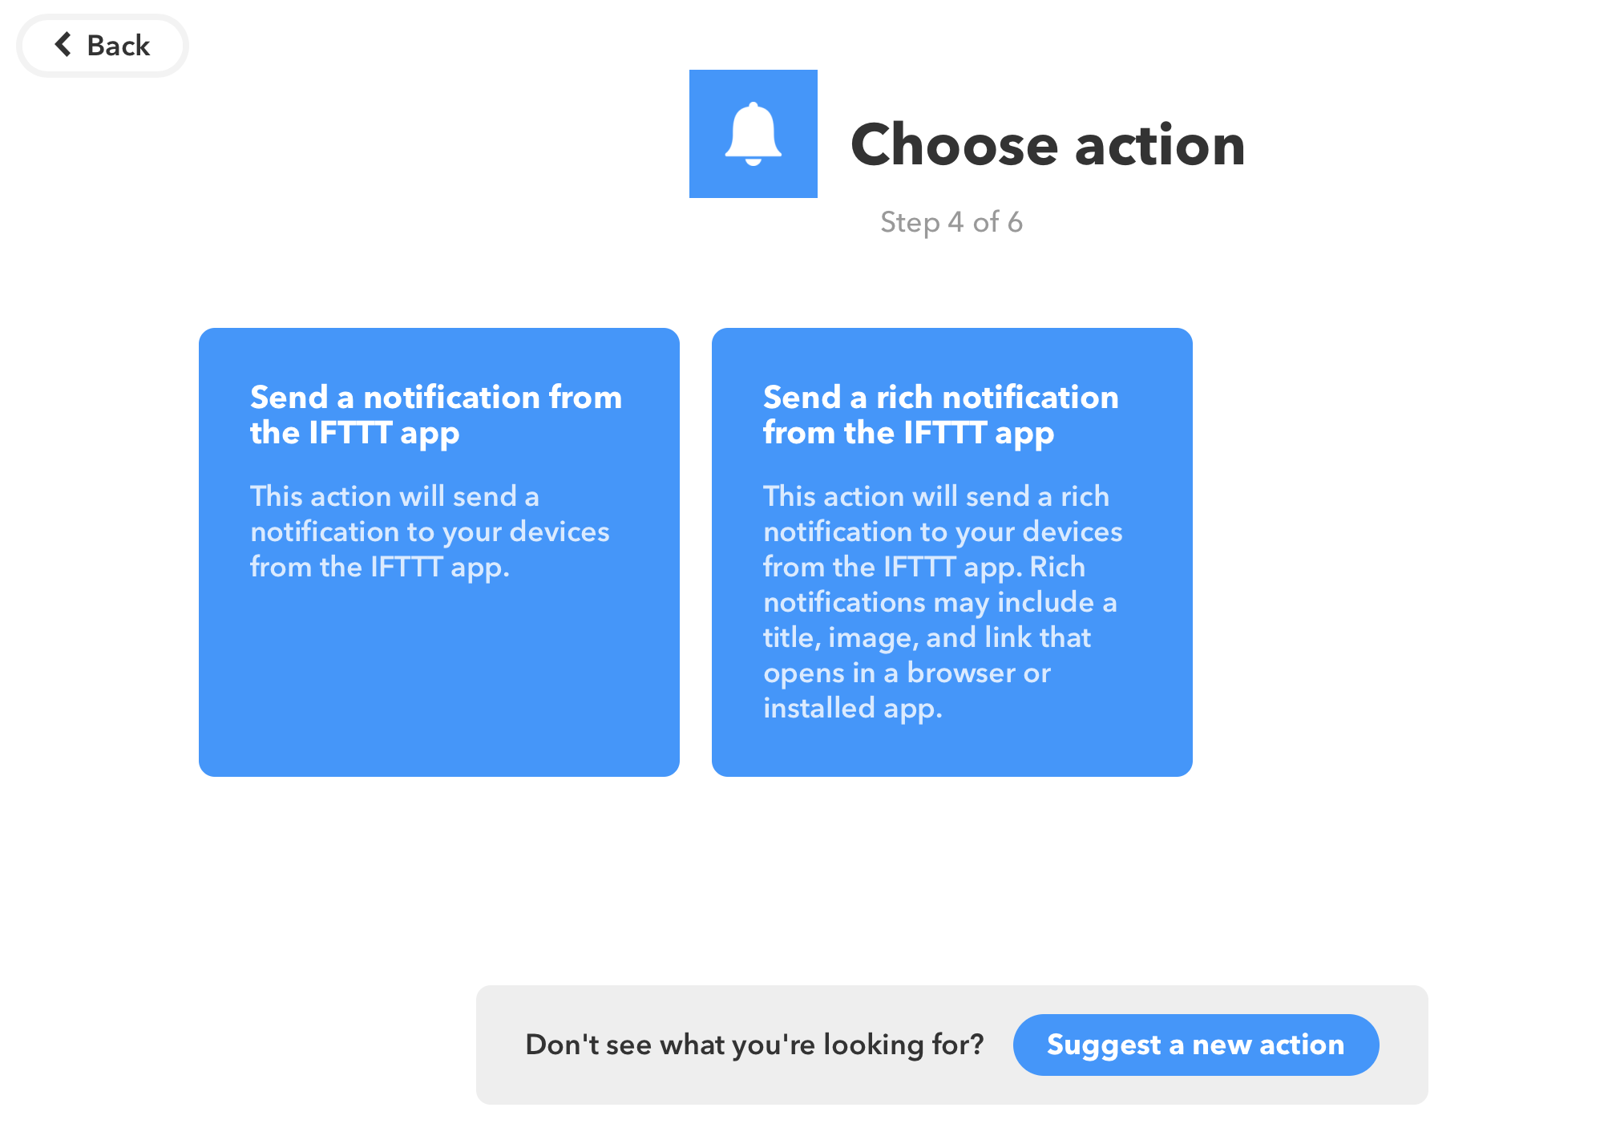
記得安裝手機 App

Slide 64
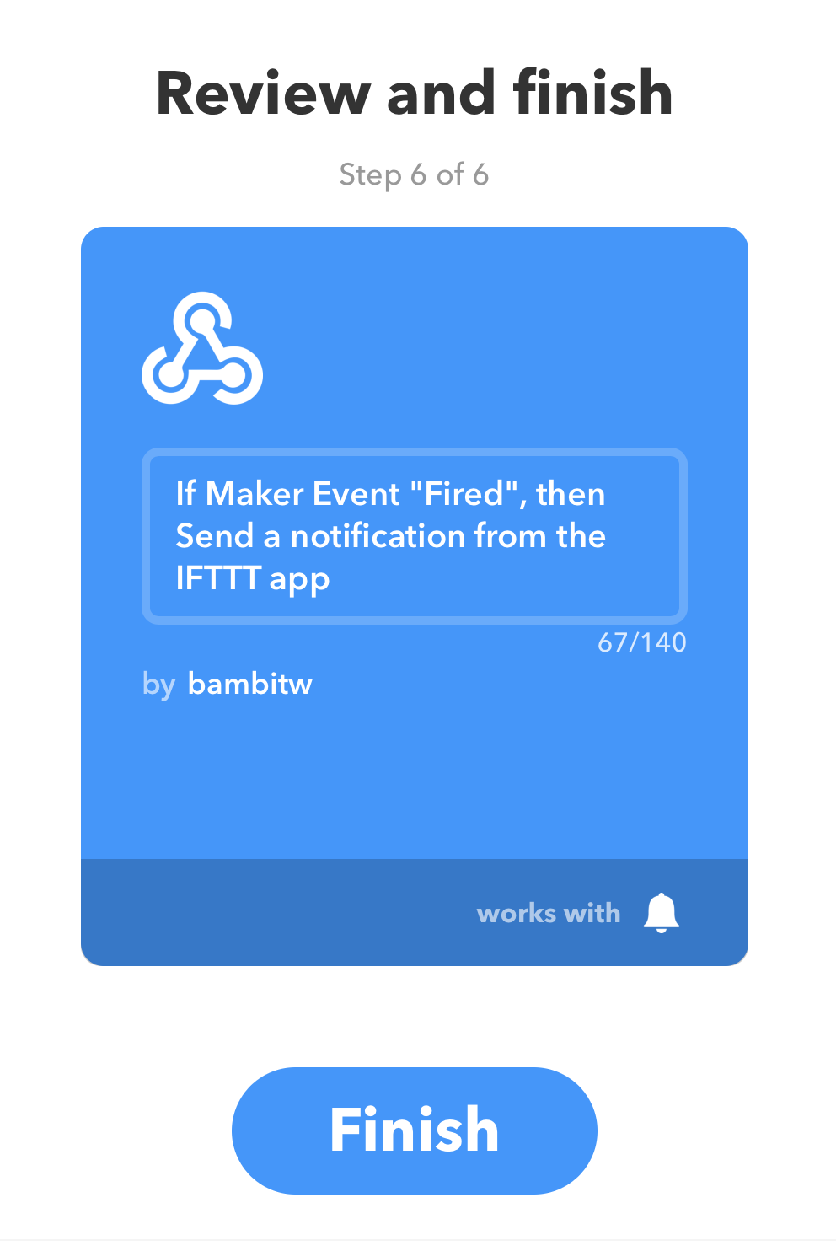

Slide 65
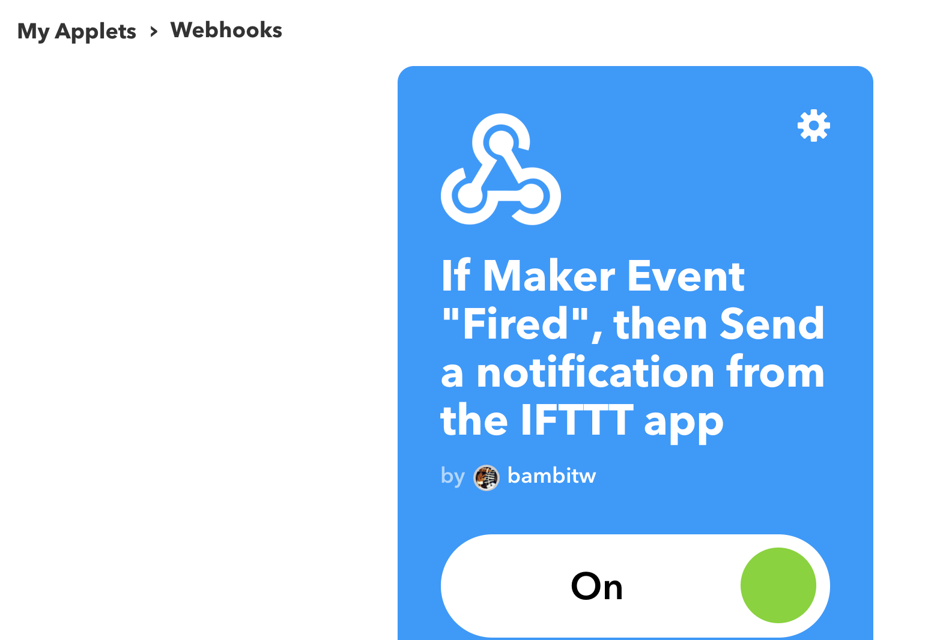
IFTTT -> My Applets

Slide 66
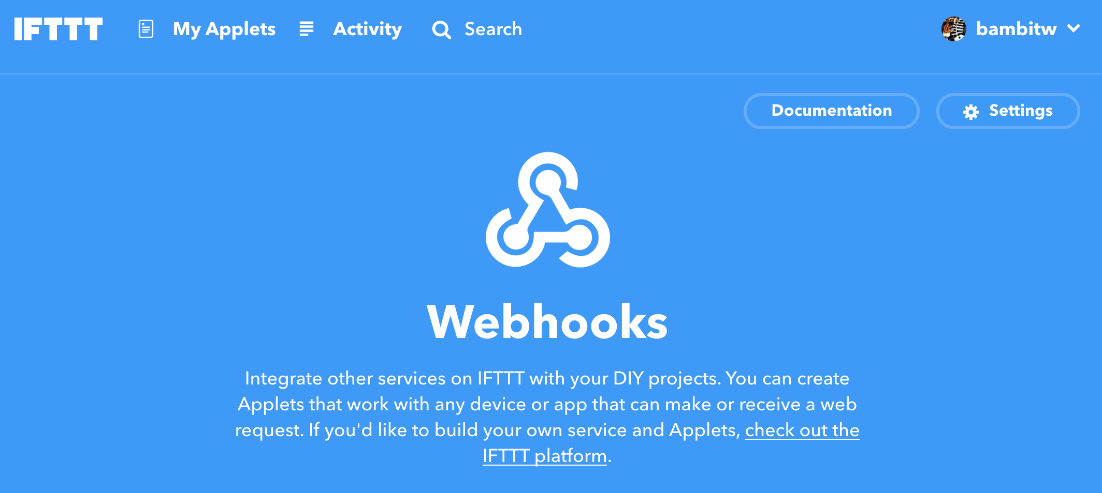
Webhook -> Documentation

Slide 67
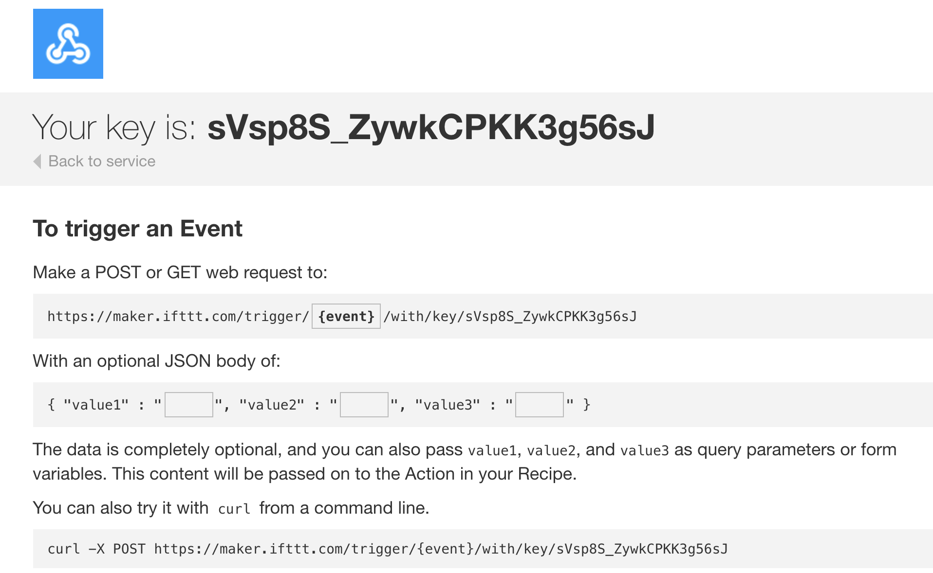
IFTTT -> My Applets, 記下 URL

Slide 68
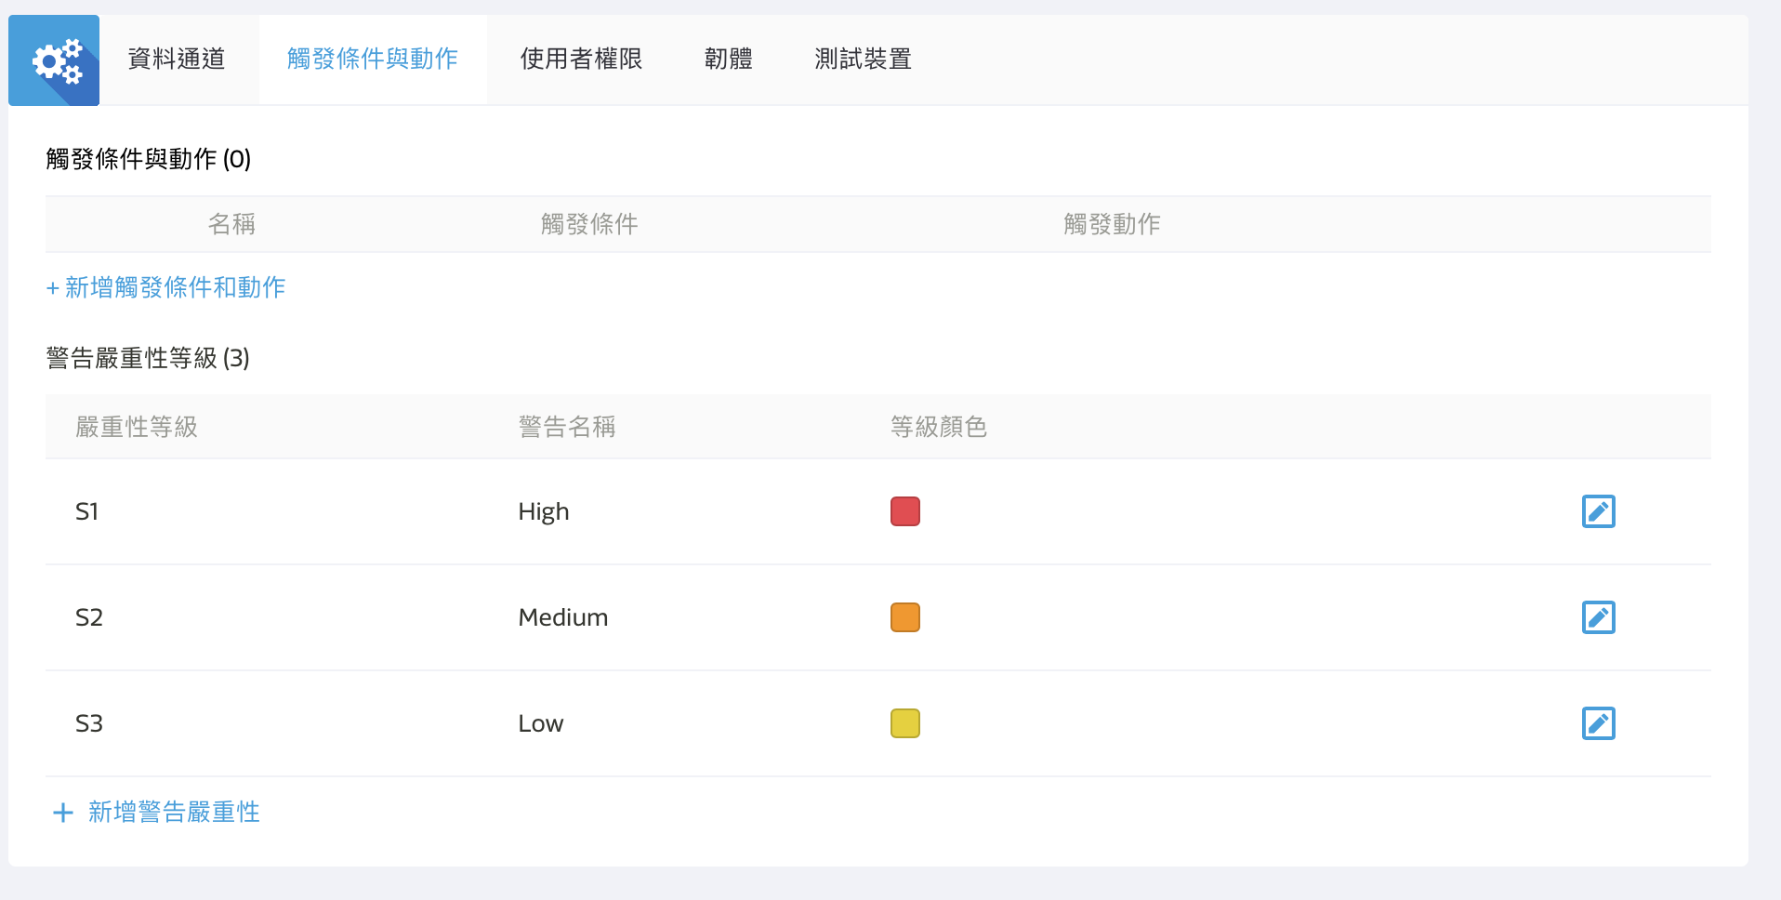
MCS Cloud產品原型/觸發條件

Slide 69
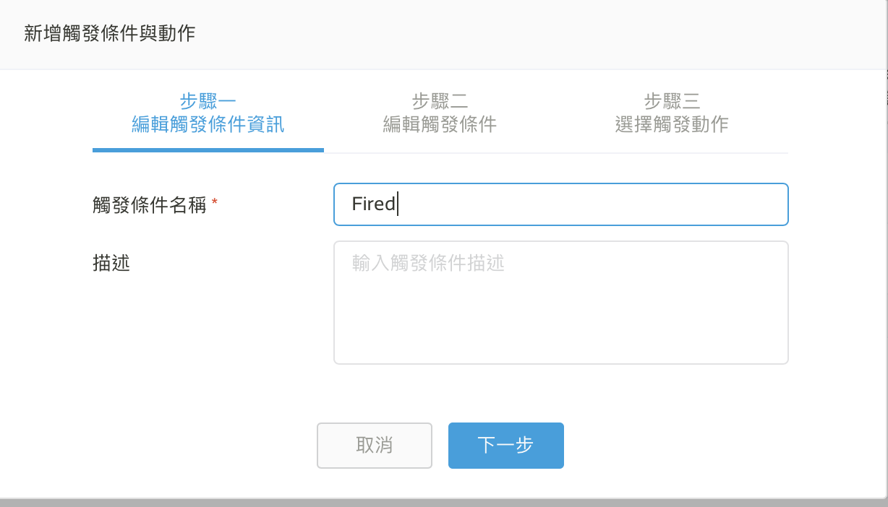

Slide 70
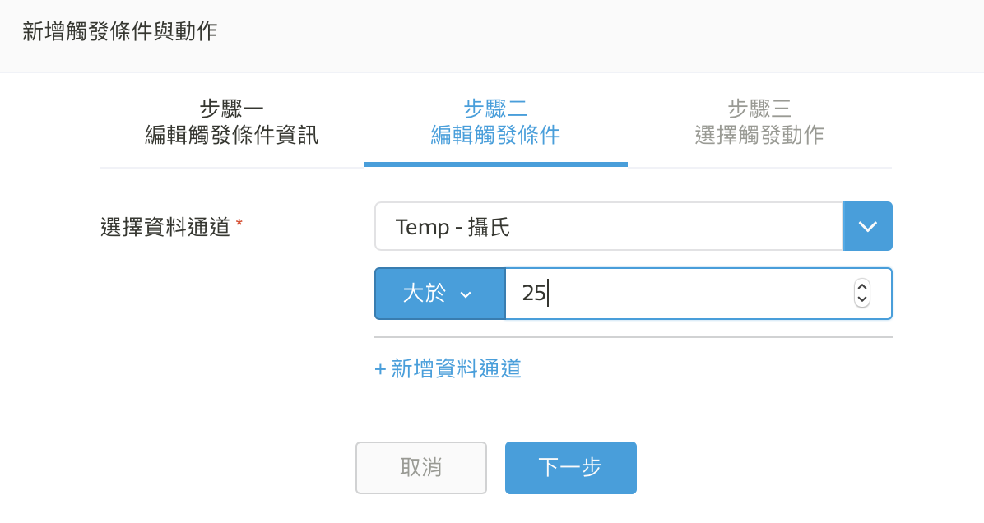
設定觸發條件

Slide 71
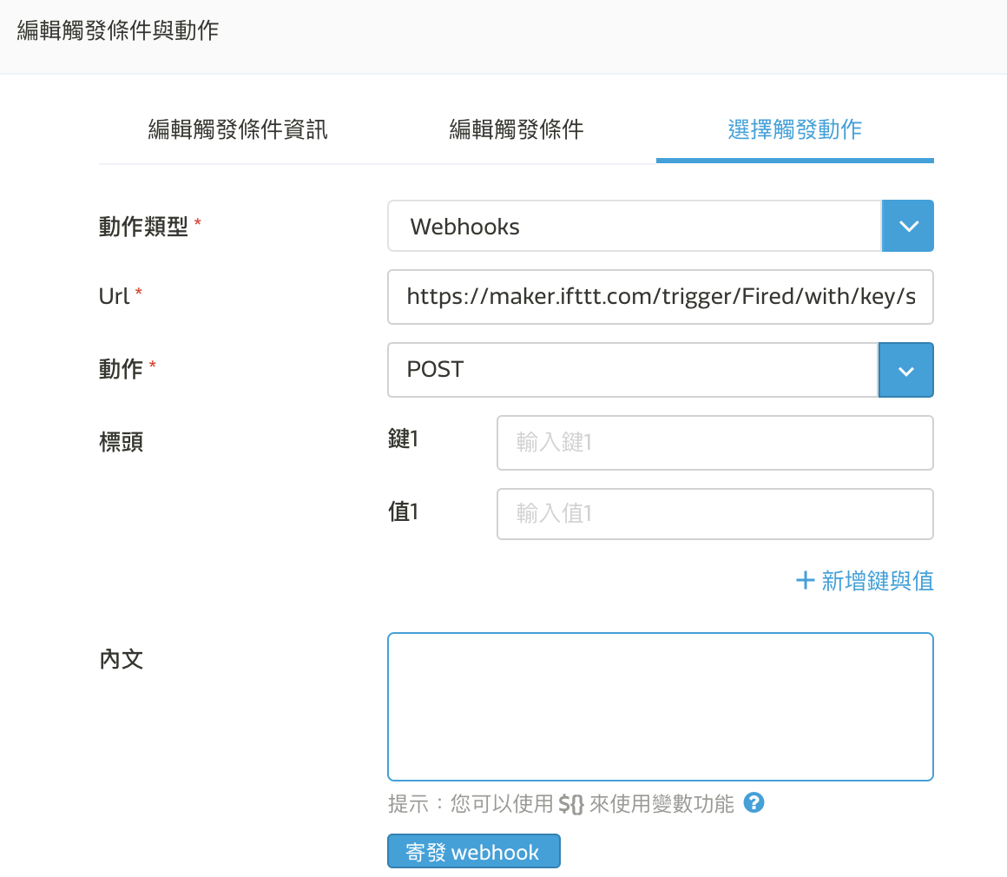

Slide 72
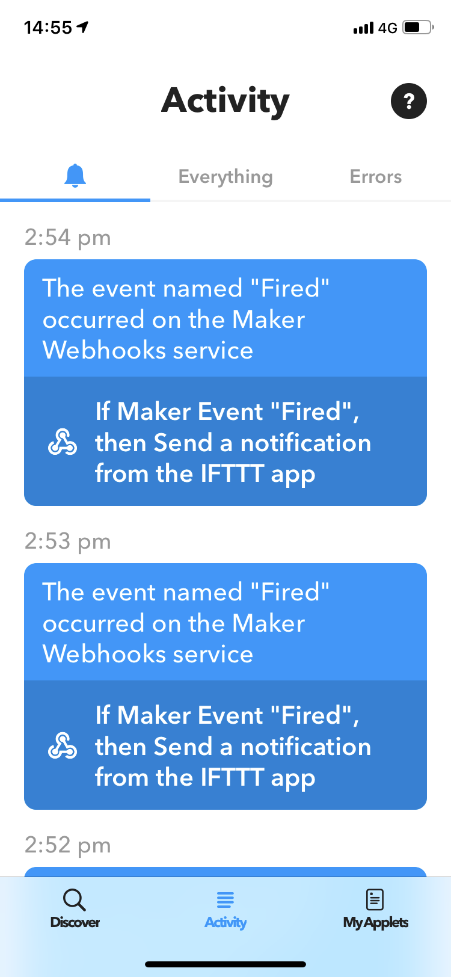
手機測試接收訊息

Slide 73
CHECK POINT 5
手機收到溫度的警示

Slide 74
由 IFTTT 控制 LED

Slide 75

New Applet, 自己定義 this

Slide 76

Ex. DateTime

Slide 77
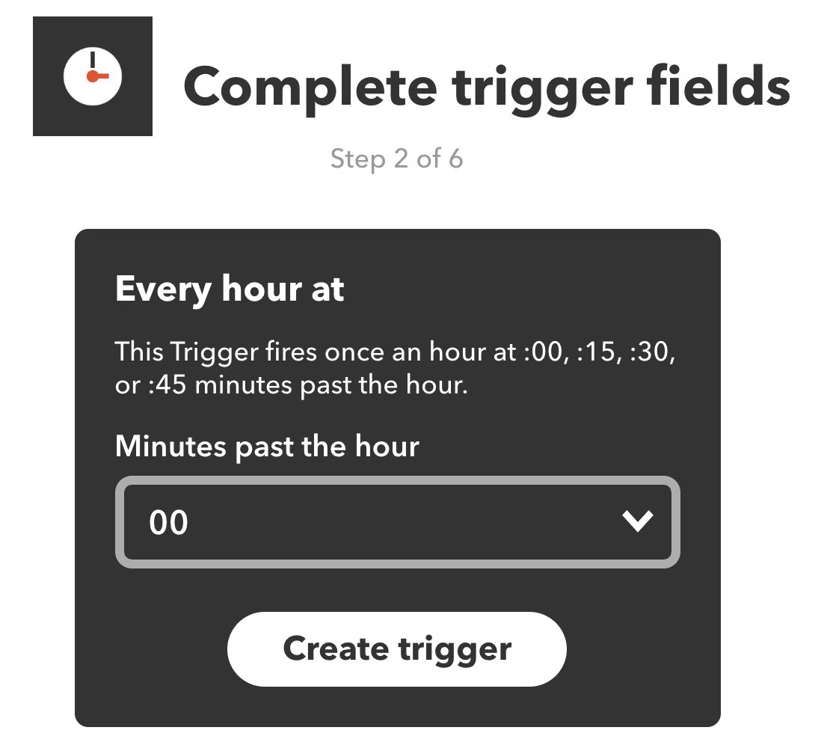
設定 Trigger

Slide 78
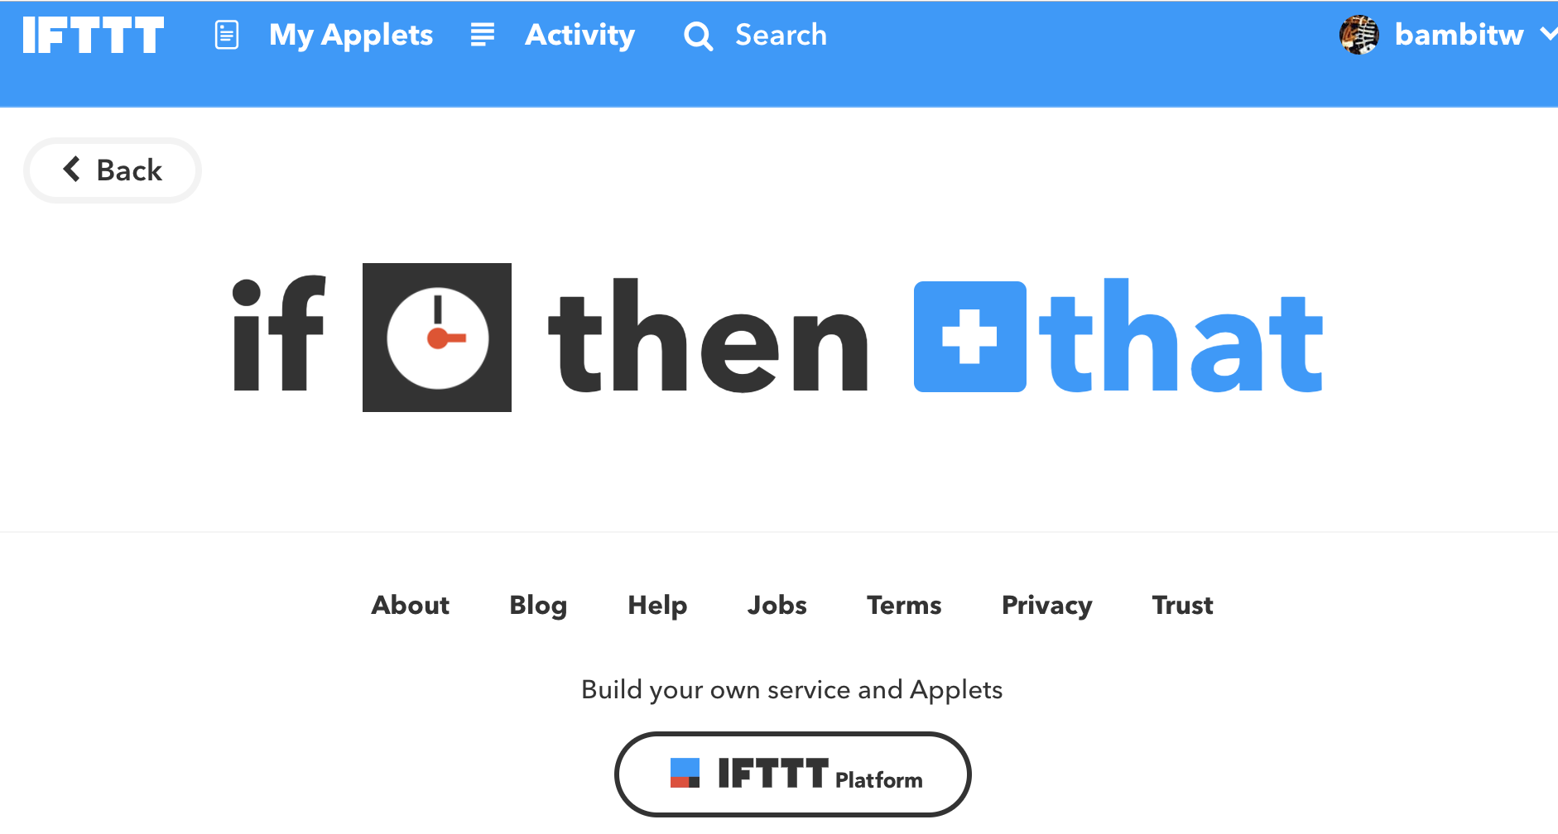
設定 that

Slide 79
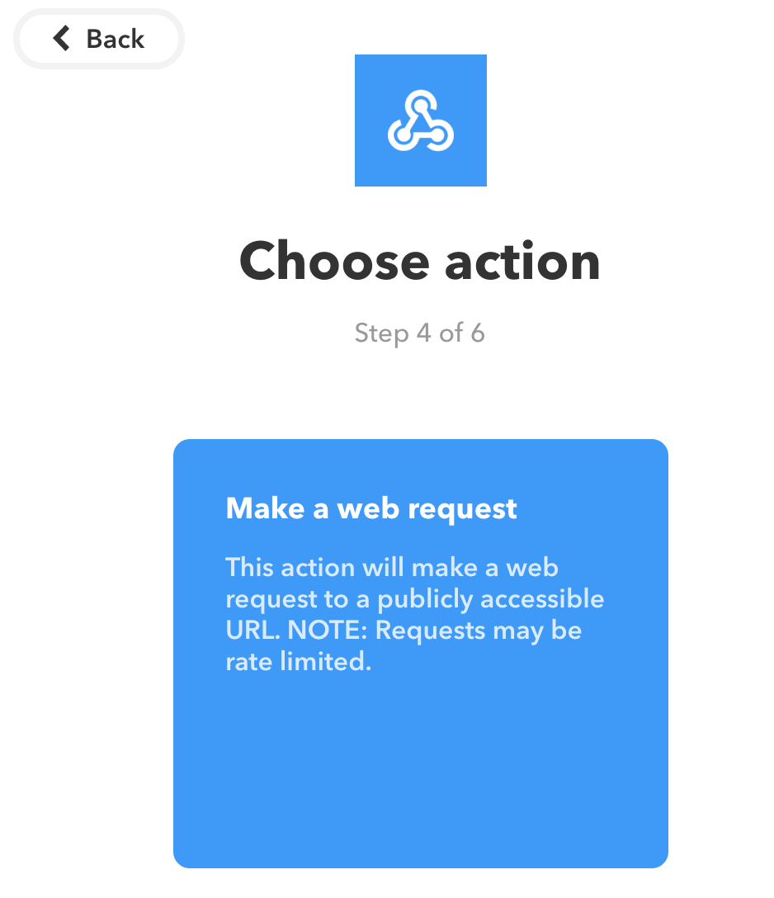
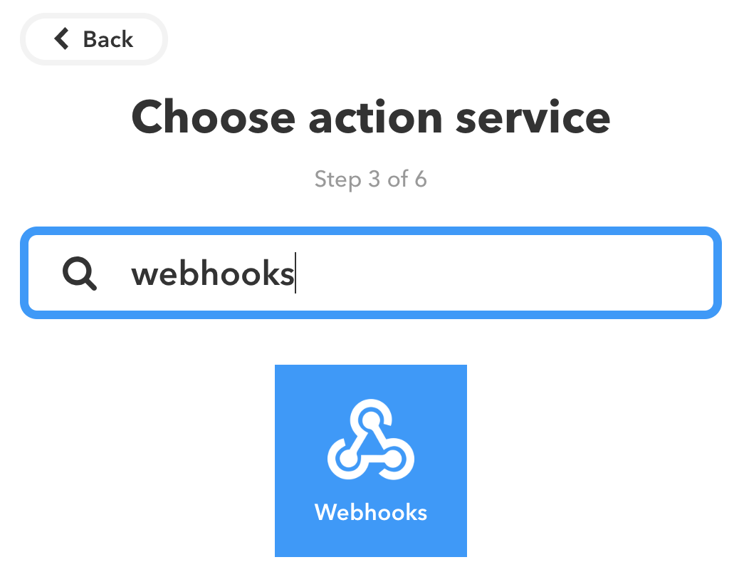
選 webhooks

Slide 80
URL: https://api.mediatek.com/mcs/v2/devices/{deviceId}/datapoints
Method: POST
Content Type: application/json
Body:
{ "appId":"{your appId}", "appSecret": "{your appSecret}", "datapoints":[ { "dataChnId":"switch", "values":{ "value":"1" } } ] }

Slide 81
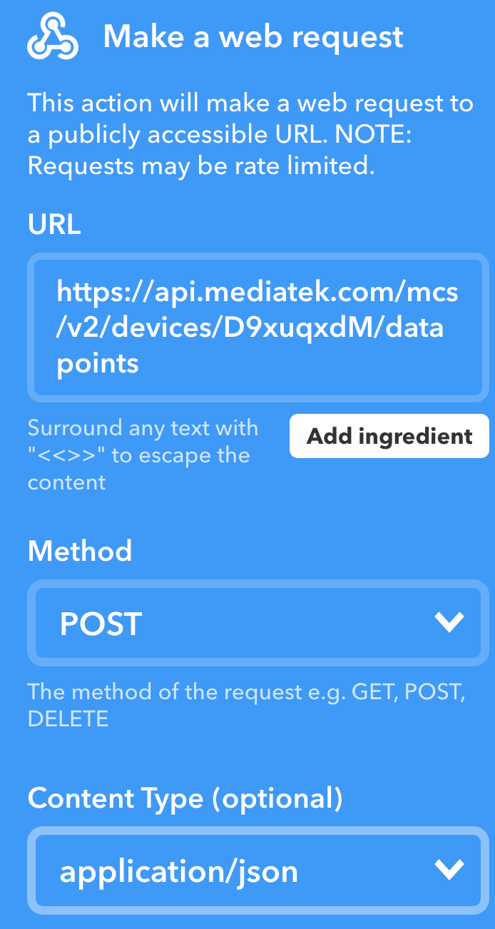
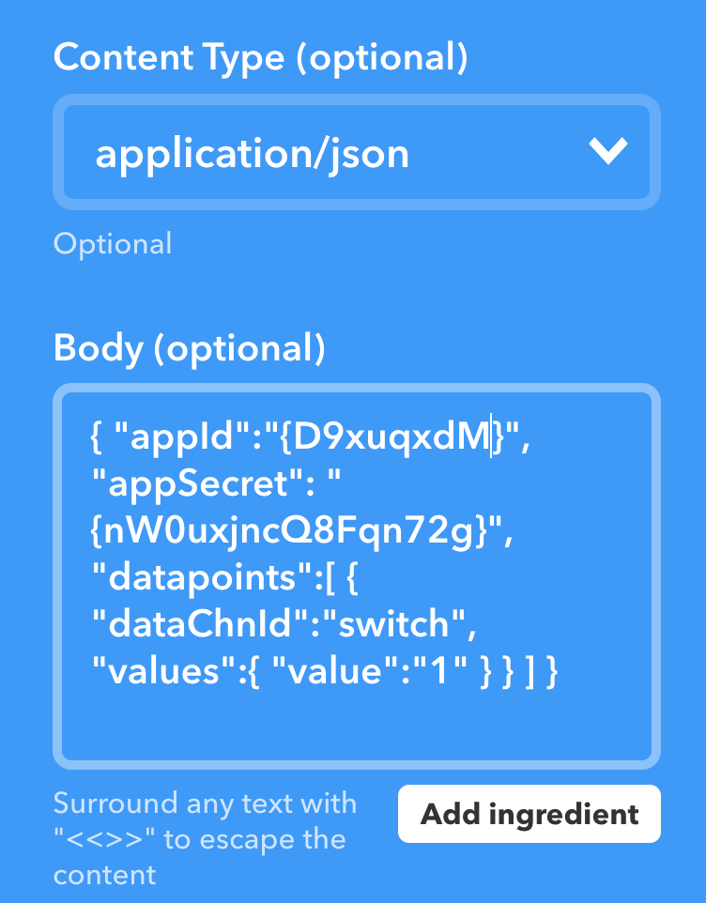

Slide 82
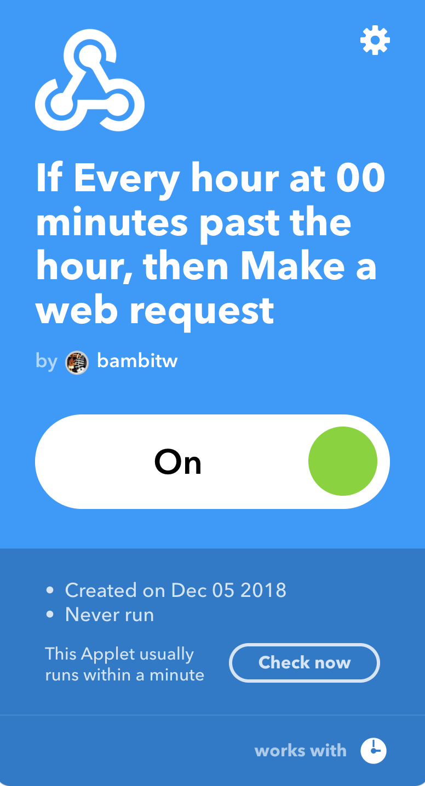
完成

Slide 83
Thinking
把 This 也改成 webhook:當溫度 > 25 度, LED 亮
將 This 改為 FB, IG, Line

Slide 84
CHECK POINT 6
手機 App 可以控制 Raspberry Pi 的 LED

